Slide 1
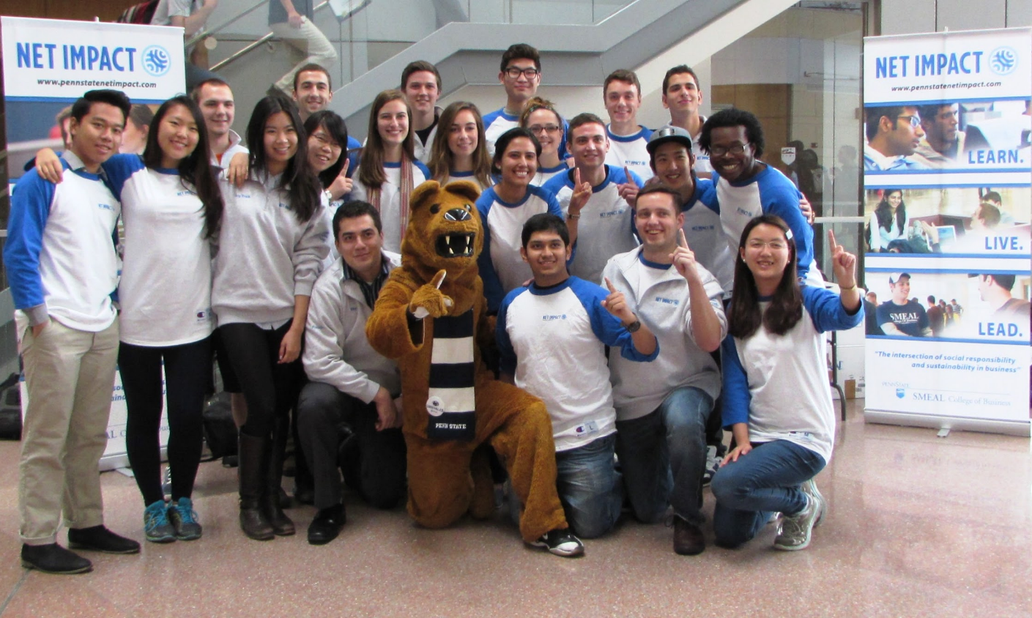
Penn State Net Impact - Undergraduate Chapter
Smeal College Of Business

Slide 2
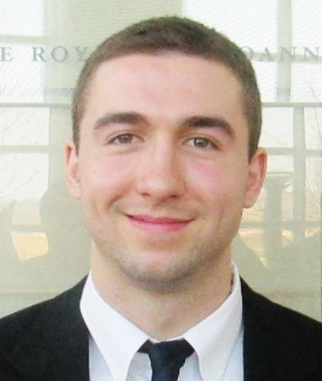
Net Impact President
Presented by: Alec Raymond

Slide 3
Net Impact is a National Organization
Undergraduate
MBA
Professional chapters
Sustainability
Corporate Social Responsibility
Ethics

Slide 4
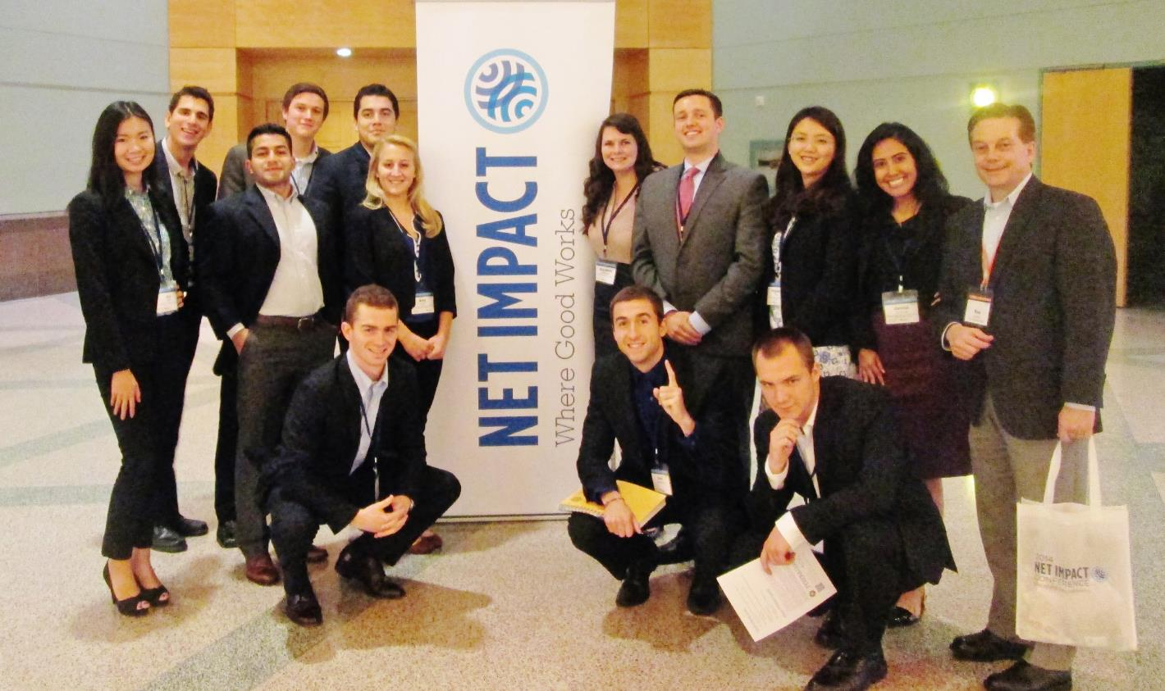
About Us
Chapter Start
On behalf of Penn State Smeal College of Business, faculty member Ron Johnson was tasked to develop the Net Impact Undergraduate Chapter
Initial communication began in Fall 2012. By January 2013, a team of 27 student founders came together to launch the chapter
Our Leadership
Our chapter’s leadership team now consists of 14 passionate students with different majors and diverse backgrounds
During Fall 2015, we took our entire leadership team to the Net Impact National Conference in Seattle, Washington to represent our Penn State undergraduate chapter.
Next year’s conference, Fall 2016, the National Conference will be in Philadelphia.

Slide 5
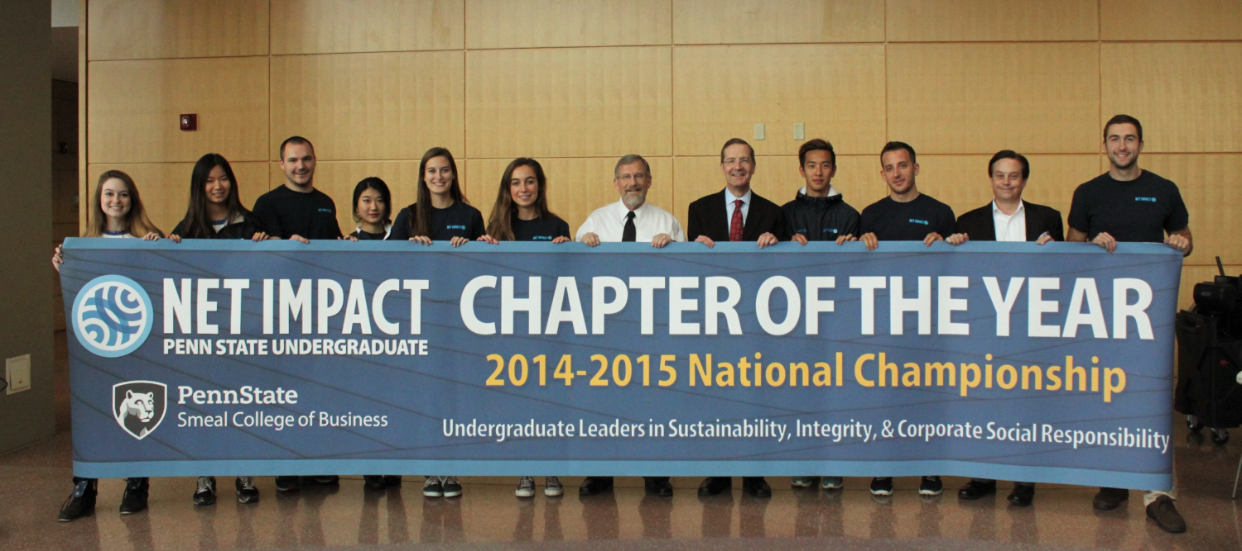
Penn State Net Impact Undergraduate
nominated the Chapter of The Year for 2014-2015

Slide 6
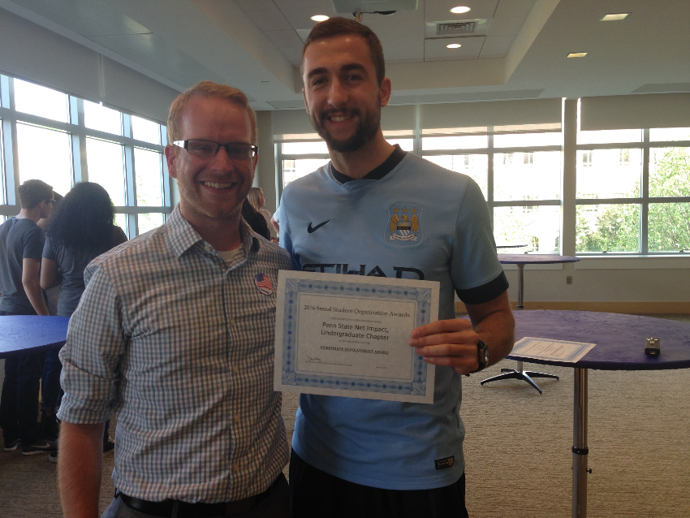
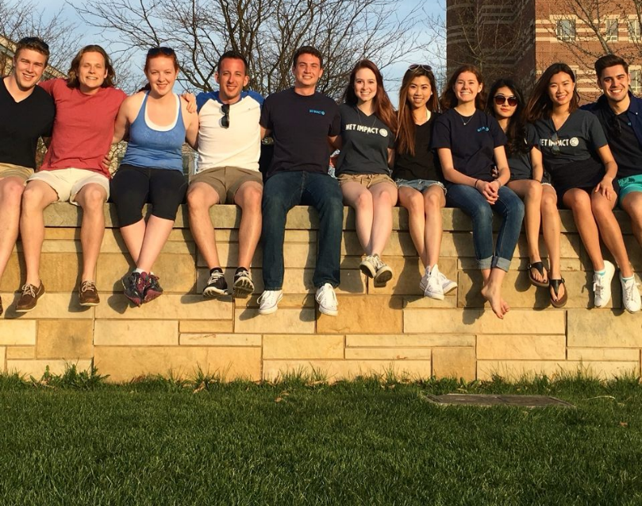
Penn State Net Impact Undergraduate
won the Smeal Corporate Involvement Award

Slide 7
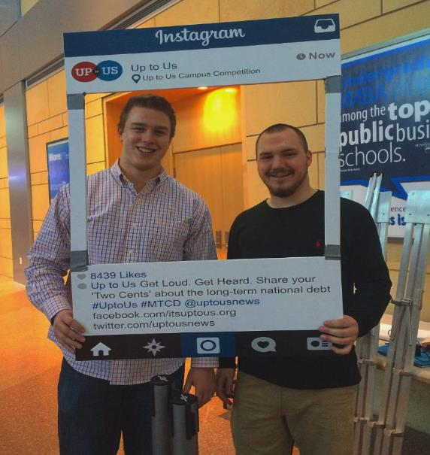
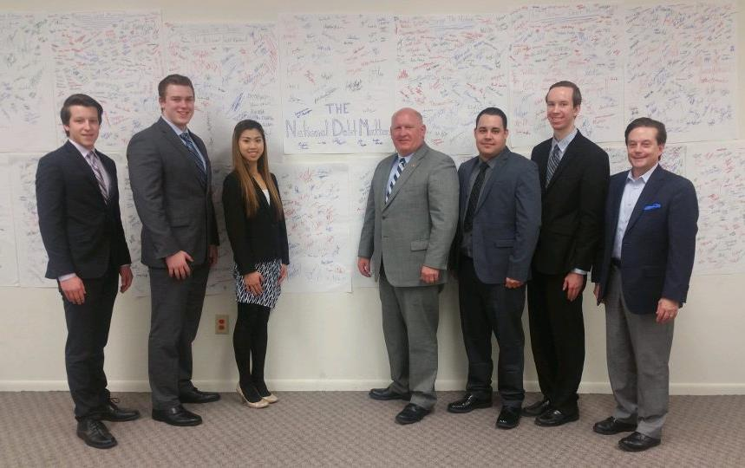
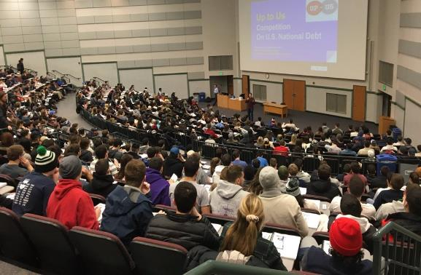
2016 Its Up to Us Runner Up

Slide 8
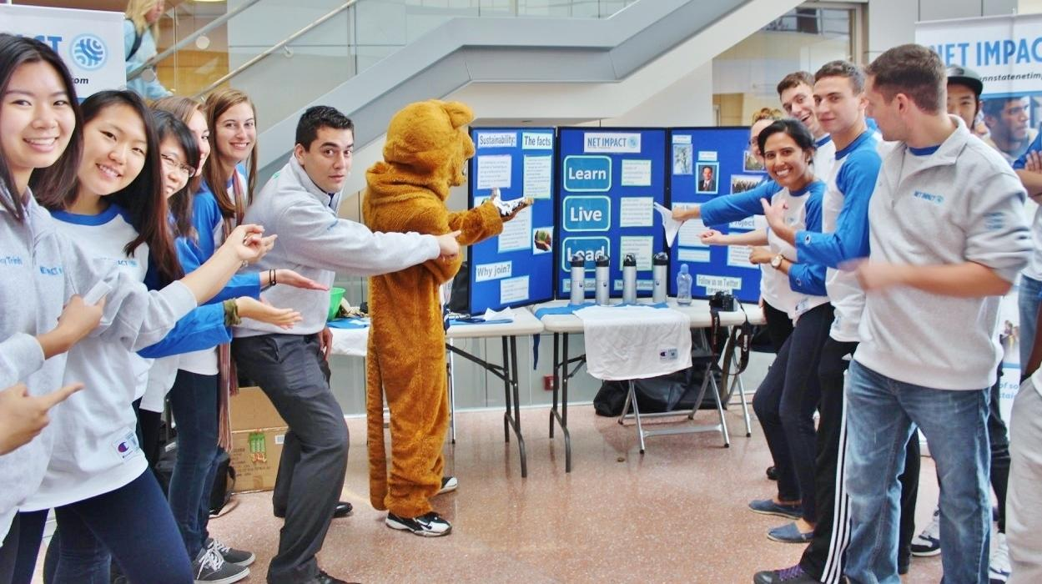
Our 3 Pillars
Learn
Live
Lead
People
Planet
Profit

Slide 9
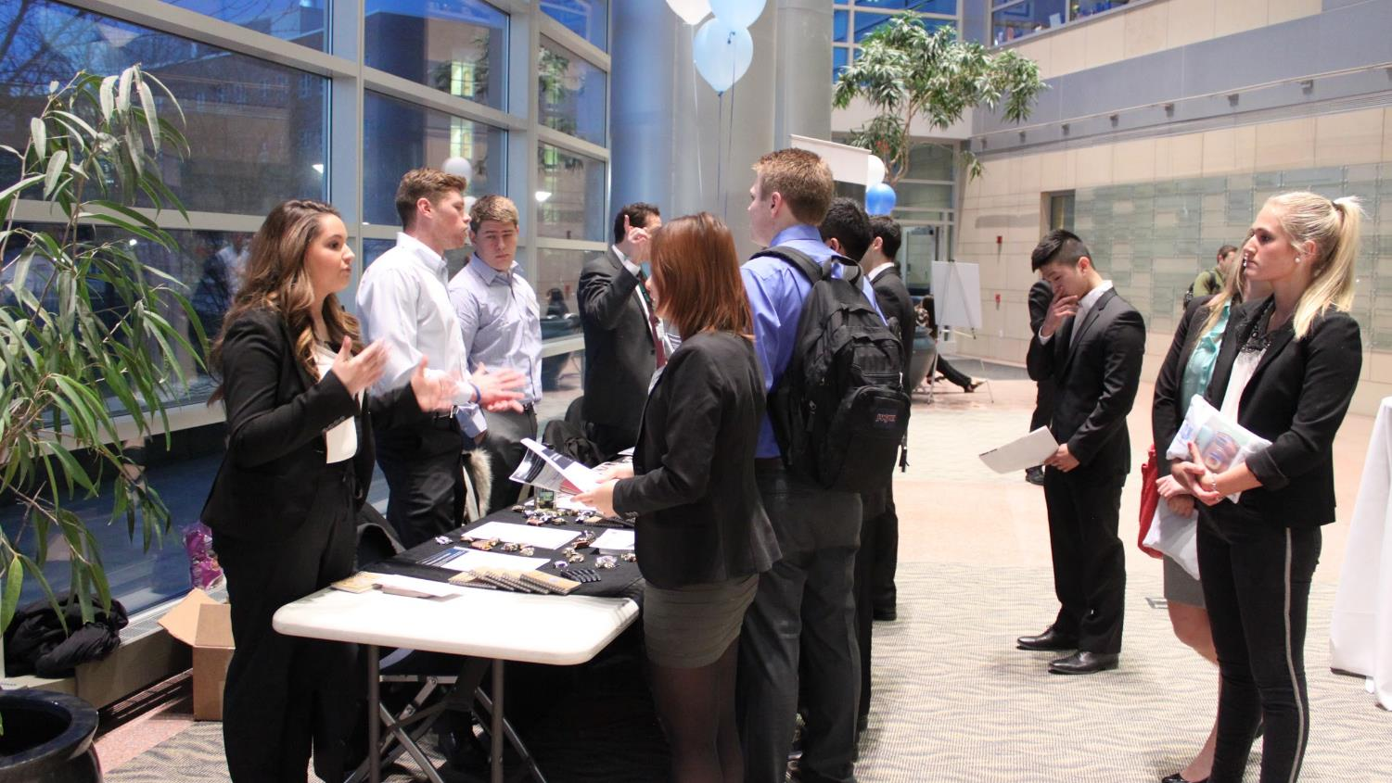
We encourage peer-to-peer LEARNing through activities and impact events
Notes:
word impact change to impactful! - Jani

Slide 10
We LIVE by Being A Diverse Organization
From 18 Countries

Slide 11
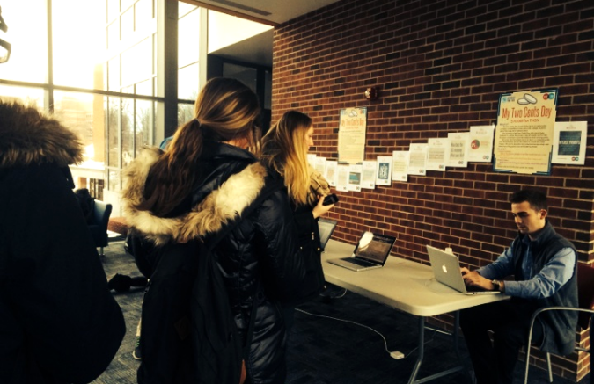
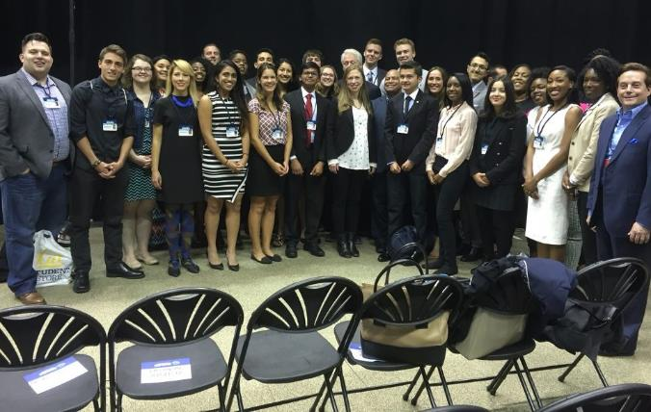
We LIVE by engaging
Up To Us Campus Challenge
Finished The Number Two School in the nation for this year
Engaged over 3,200 students at our three events
Kiva Case Competition
3rd place winner for Fall 2014
2nd place winner for Spring 2015
2nd place winner for Fall 2016
IBM Case Competition
3rd place winner for Spring 2015
PWC Case Competition
Kohl's Case Competition
Starting our own Case Competiton

Slide 12
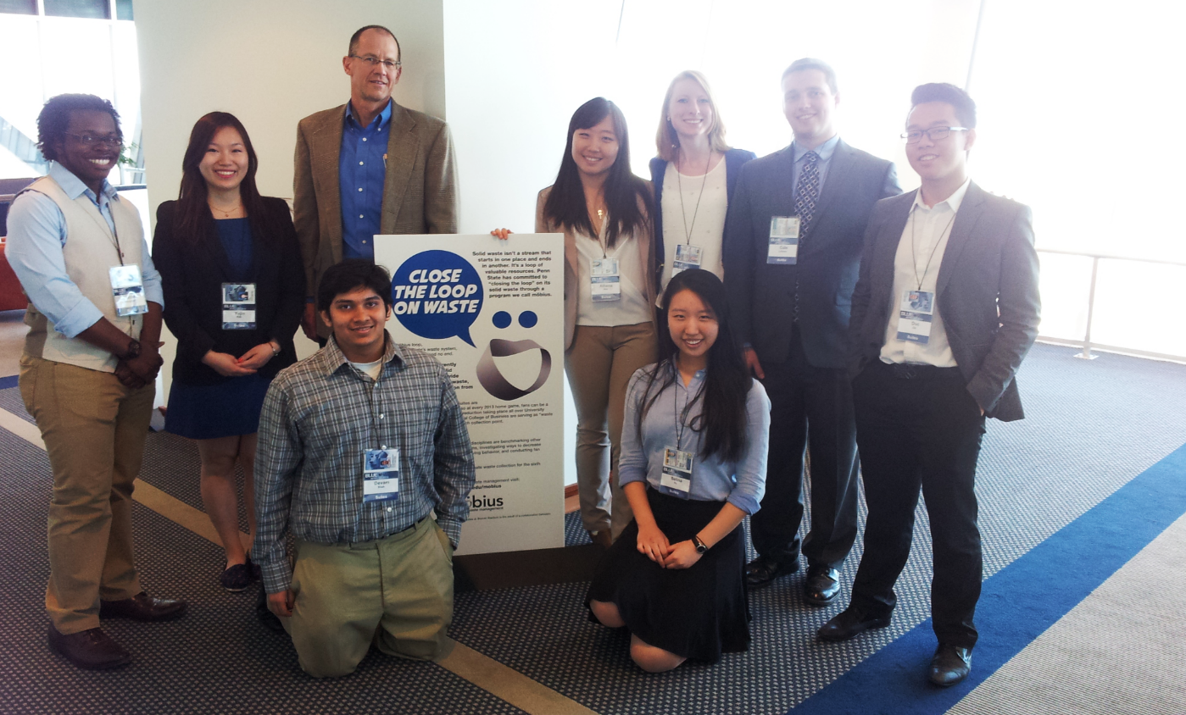
We LEAD
through new initiatives
Beaver Stadium Zero Waste Project in an 106,000 seat football venue

Slide 13
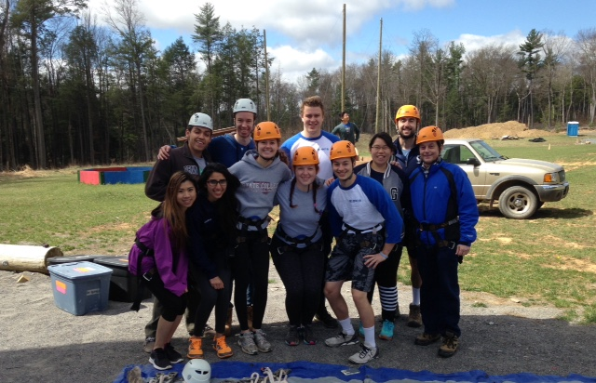
Powerful Initiatives
Annual Smeal Corporate Citizenship Conference,March 15&16
2,000 attendees
Pro-Bono Consulting Program,
Fall 2015
2 projects
Executive Board training session
First of its kind
Worked on Team Work
Developed Leadership Skills

Slide 14
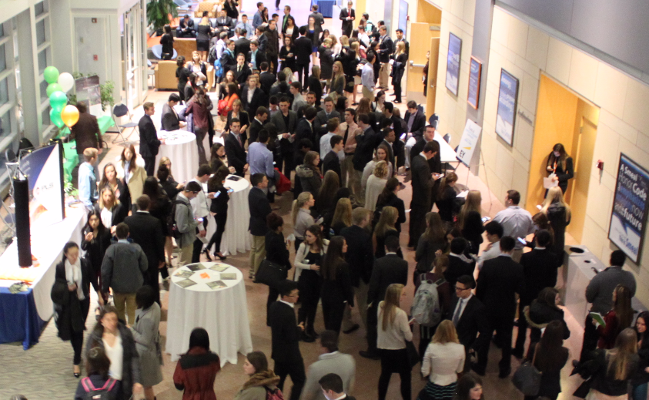
Corporate Social Responsibility
Integrity
Sustainability

Slide 15
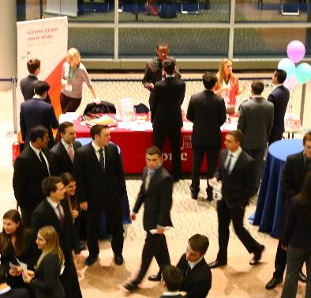
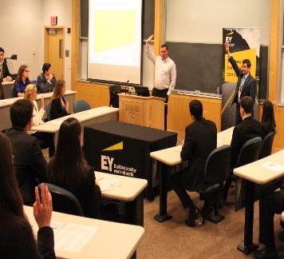
In 2016...
14
Companies
2000+ Students

Slide 16
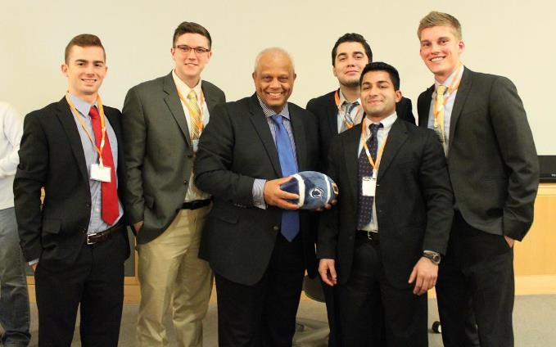
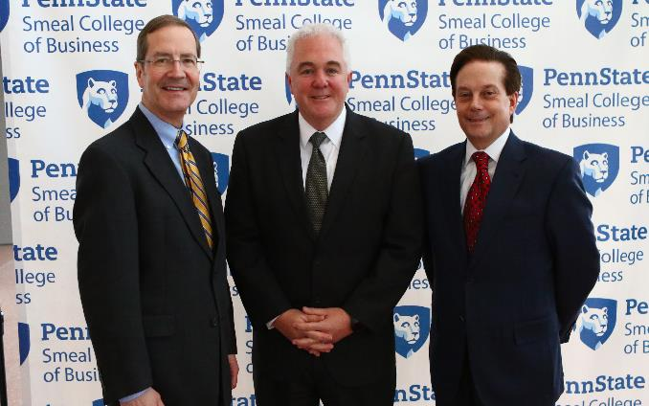
Smeal Corporate Citizenship Conference
MISSION: Create opportunities for professionals and students to connect and discuss the growing and essential business aspects of Integrity, CSR and Sustainability
2015 Keynote speaker: Lord Dr. Michael Hastings, Global Director of Citizenship for KPMG and member of Great Britain’s House of Lords
2016 Keynote Speaker: James Gowen, Vice President Supply Chain Operations and Chief Sustainability Officer, Verizon

Slide 17
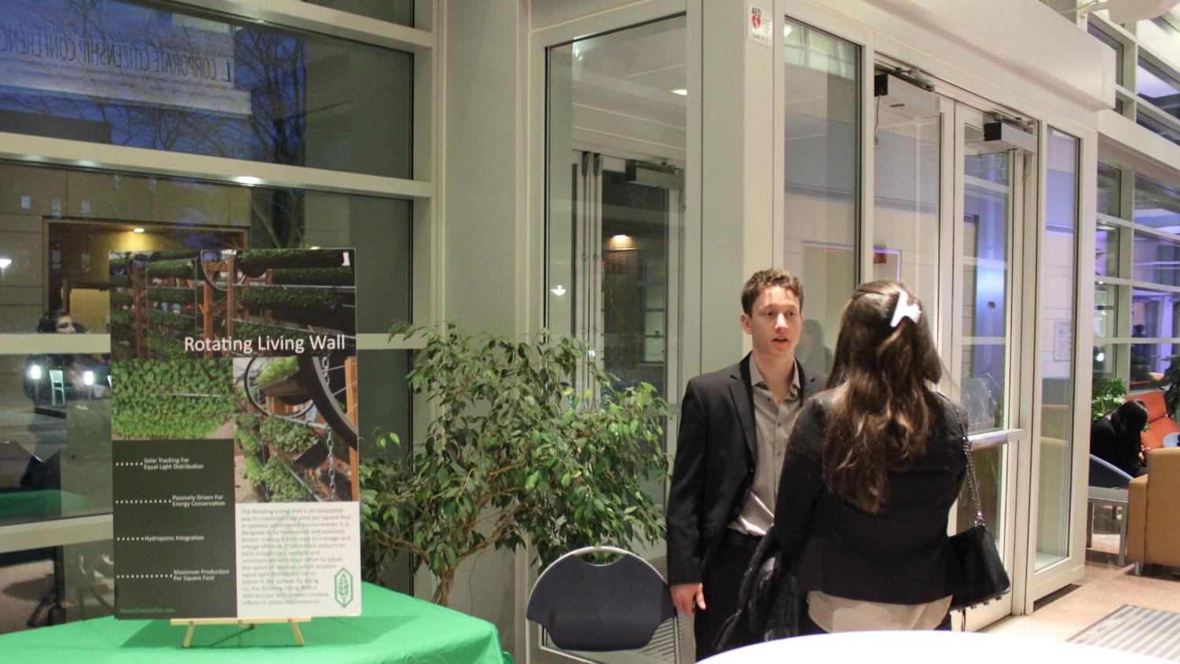
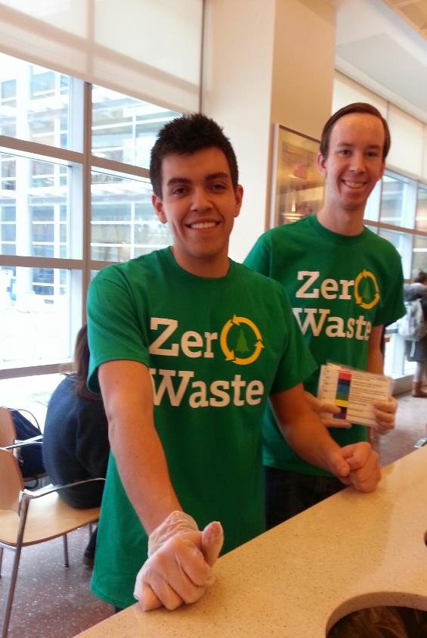
Pro-Bono Consulting Program
Blue Chip Bistro
Project on improving waste management at Blue Chip Bistro Cafe located within the Smeal College of Business at Penn State
Start Date: September, 2015

Slide 18
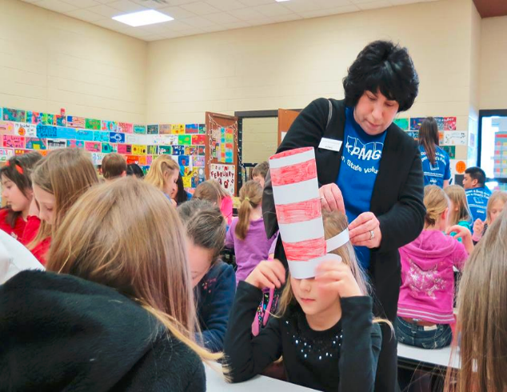
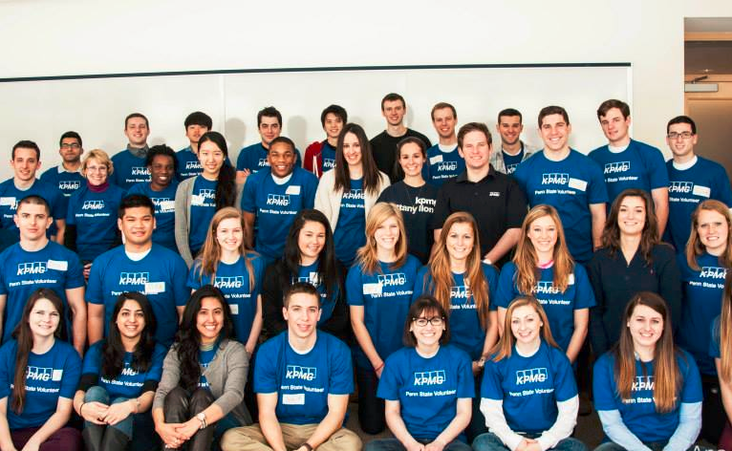
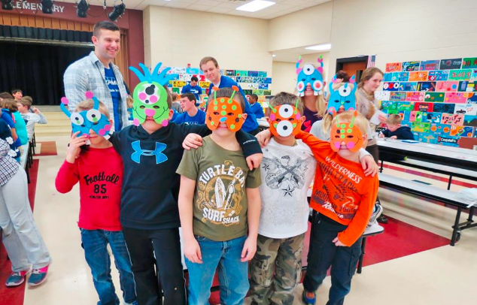
Service Corps Division
Corporate Engagement
KPMG Family For Literacy Event with 40 students volunteering with 200 elementary school kids

Slide 19
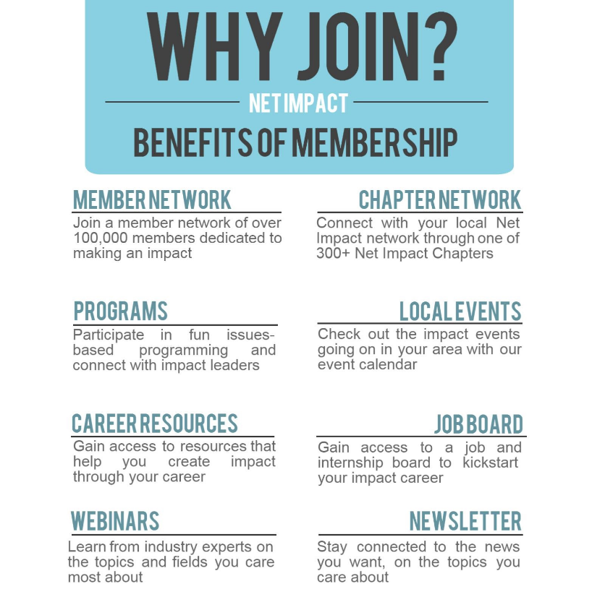
Net Impact provides support
Net Impact is a great platform to build off of
Net Impact helps make a difference

Slide 20
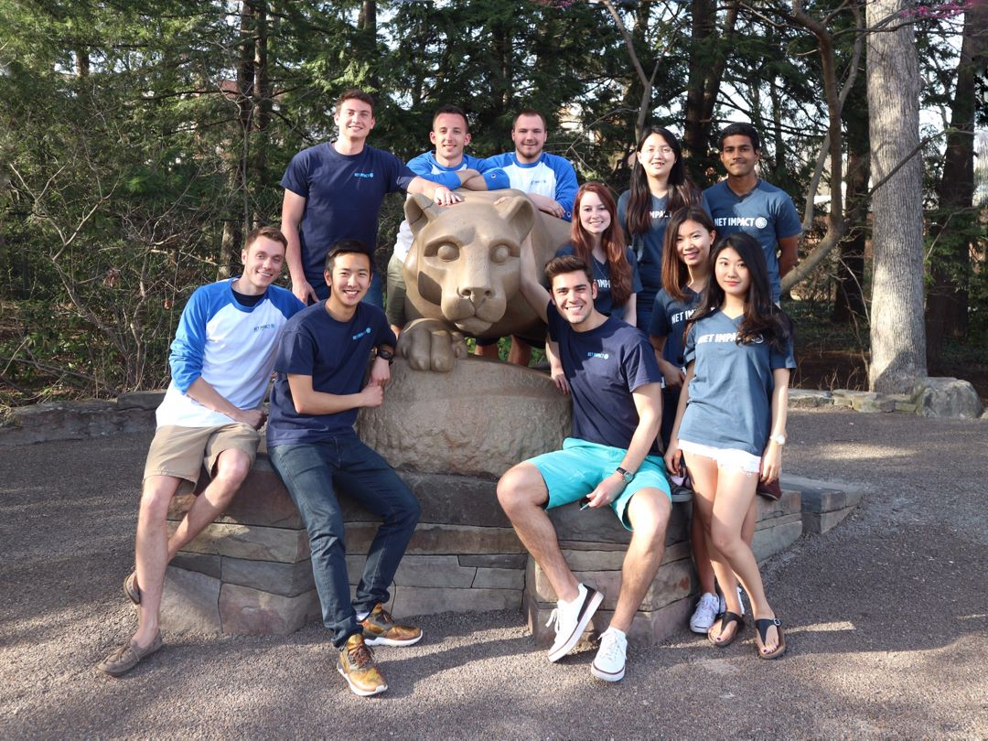
Thanks!
From the Penn State Smeal College of Business
Net Impact Executive Board
Any questions?
Please contact -
Alec Raymond:
acr5339@gmail.com

Slide 21
Credits
Special thanks to everyone who helped our chapter grow and continue our achievements:
Net Impact National and members of our undergraduate chapter at Penn State
Smeal Sustainability Advisory Board
Dean Charles Whiteman, Smeal College of Business
Terry Harrison and Gerry Susman as current and former Smeal College of Business Sustainability Directors, respectively
Ron Johnson, Faculty Advisor
SMEAL CORPORATE CITIZENSHIP CONFERENCE
Net Impact Video
Our Website
Presentation template by SlidesCarnival

