Slide 1
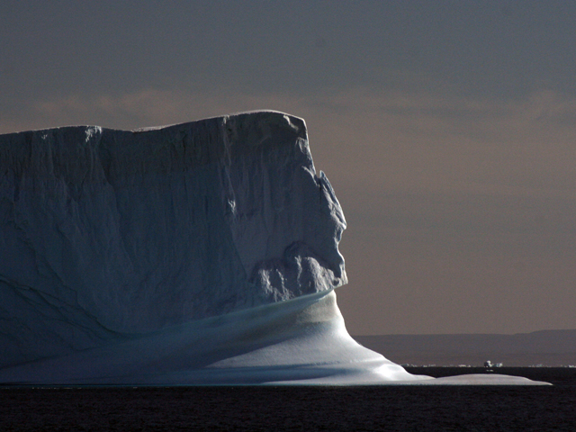





Finding a Better Future in Changing Times Energy, Environment and Sustainability
Richard B. Alley
Penn State
PA Environmental Resource Consortium
Oct. 24, 2016
Please note: I work for
Penn State University,
help UN IPCC, NRC, etc., But I am not representing them, just me.
G. Comer Foundation
Notes:
Sustainability is not optional; our long-term health and well-being depend on finding ways to live well now and in the future. We face large challenges, but with larger opportunities. We have the tools to build a brighter future, with a bigger economy, more jobs, greater national security and a cleaner environment more consistent with the Golden Rule. But, that future won’t build itself.

Slide 2
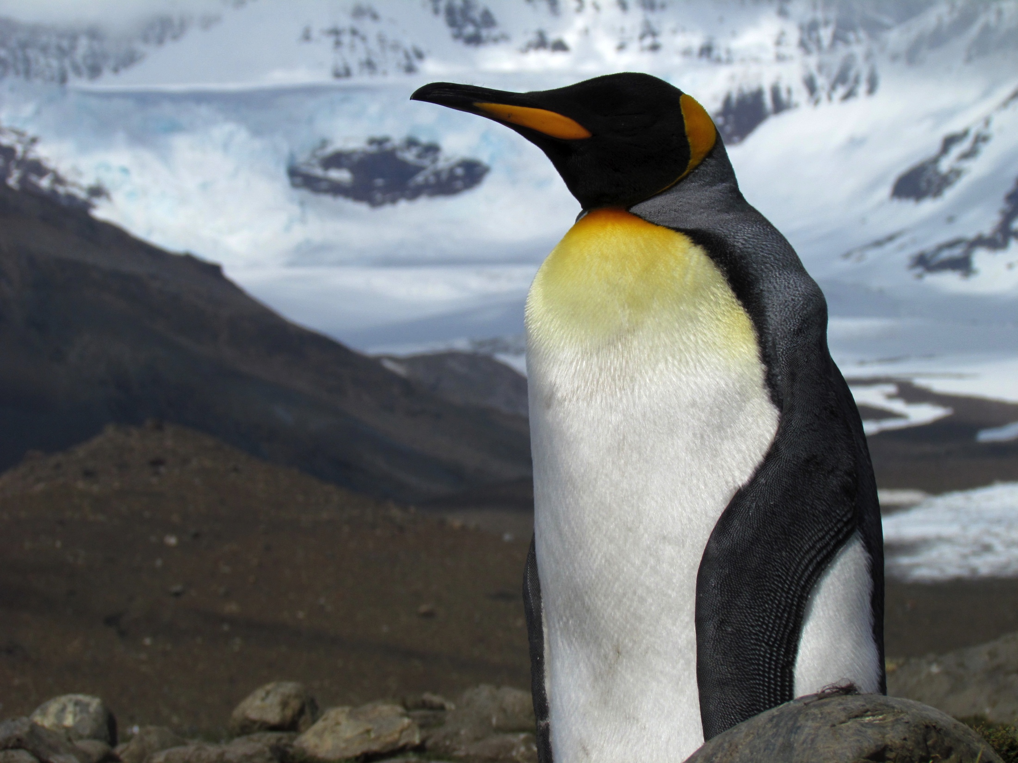
Thanks to you for coming and to Brandi Robinson and Josh Hooper for inviting me and arranging
G. Comer Foundation

Slide 3
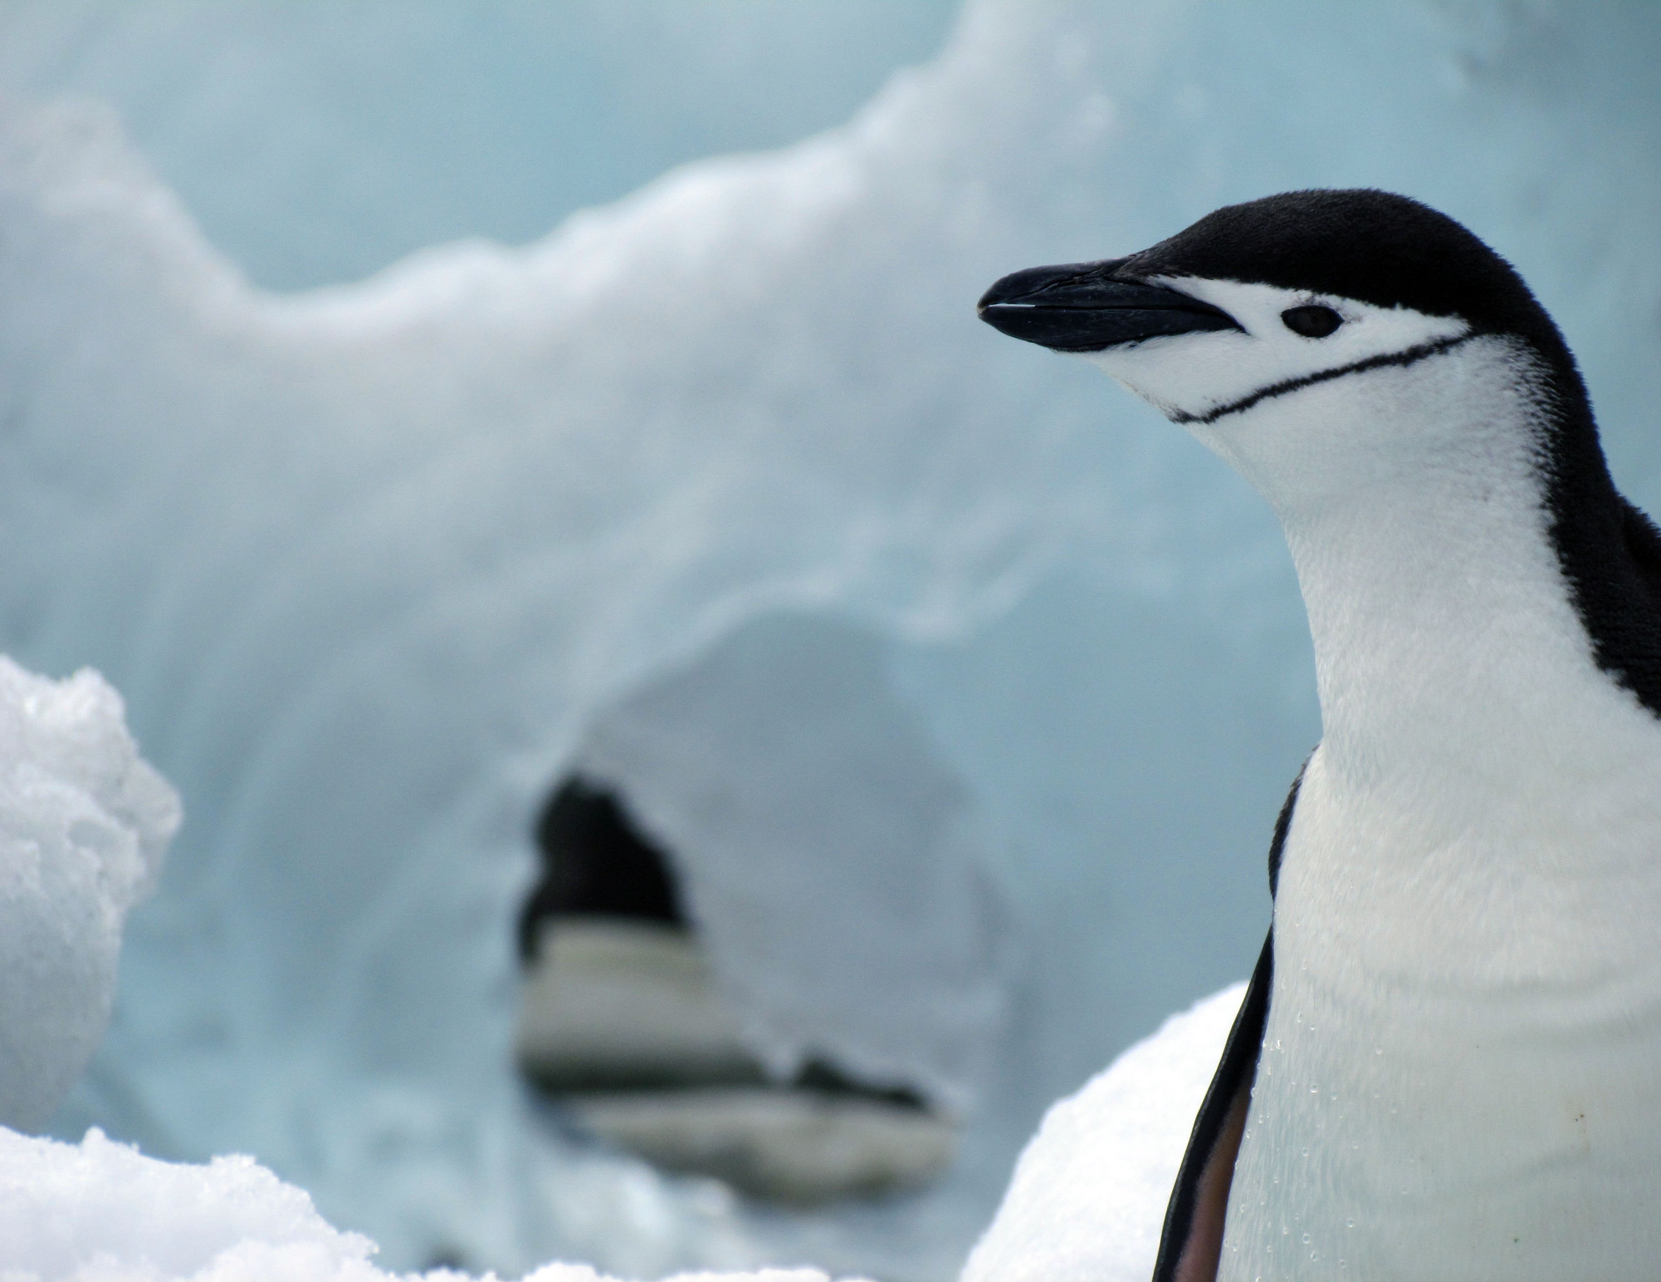
Sustainability
Living so we can live well
And so can our grandkids
And their grandkids
And other critters on Earth…

Slide 4
Sustainability
If we had more time, we’d go over history:
Earth rather clearly was overpopulated with a few million hunter-gatherers
Who were contributing to extinctions of their food 10,000 years ago
But we learned and taught, grew and built
So now we have more than 7 billion of us
Learning, teaching, building, growing, are NOT optional—you are essential

Slide 5
Sustainability
Oversimplifying a lot, people choose to have just enough kids to replace themselves if, and only if, they:
Are confident their children will survive;
Have choices about what to do in life.
If we succeed in supplying these, Earth’s population is projected to stabilize at 9 or 10 billion within a few decades;
If we don’t supply these…?????

Slide 6
Sustainability
With about 7 billion of us on Earth, maybe 5 billion of us are doing well on this
So sustainability requires doubling the number of people with choices in life, and confidence that their children will survive
But, a lot of the support we use now is unsustainable; we are using up things that nature is not replacing fast enough to help
Many issues (food, water, soil, …). I’ll do energy, but first, a cold interlude…

Slide 7
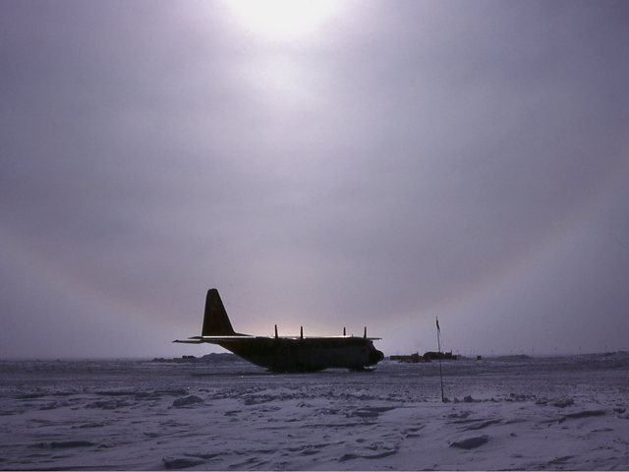

Slide 8
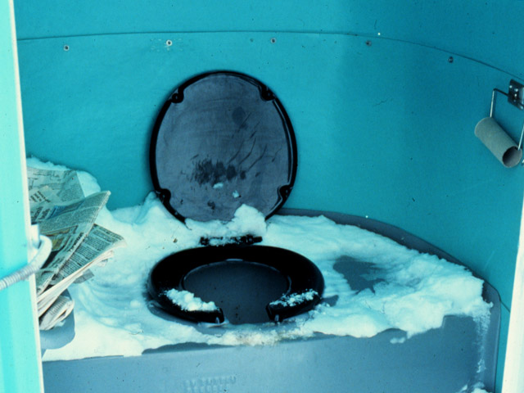

Slide 9
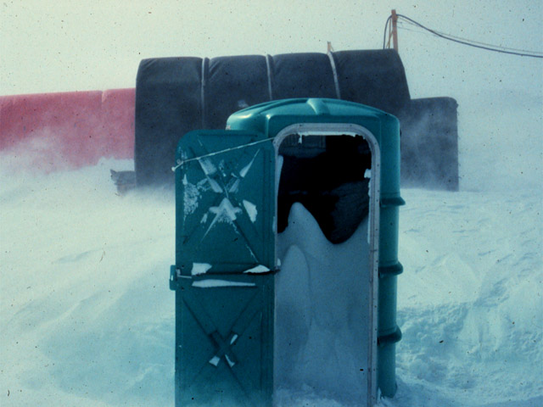

Slide 10
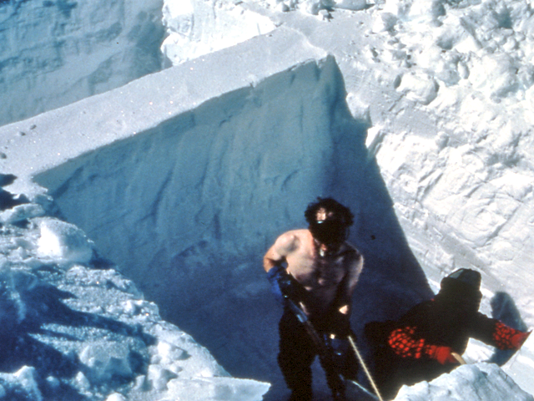

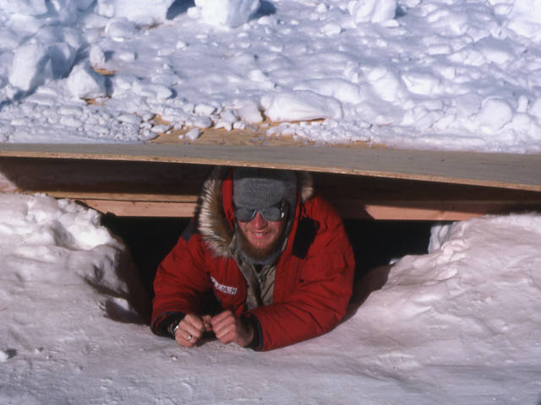
Joan Fitzpatrick

Slide 11
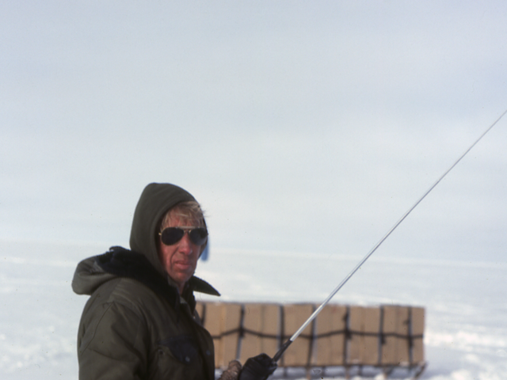
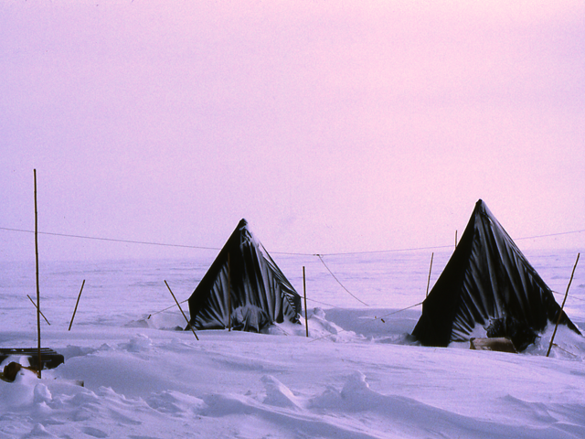

Slide 12

ww.nps.gov/grca/planyourvisit/cell-phone-audio-tours.htm

Slide 13
Energy use
What we do for ourselves:
100 W
What’s done for us—more than
10,000 W

Slide 14
Energy use in different units
What we do for ourselves:
2,000 Calories per day
What’s done for us—more than
200,000 Calories per day

Slide 15
Energy use in different units
What we do for ourselves:
2,000 Calories per day
What’s done for us—more than
200,000 Calories per day
More than 80% Fossil Fuels

Slide 16
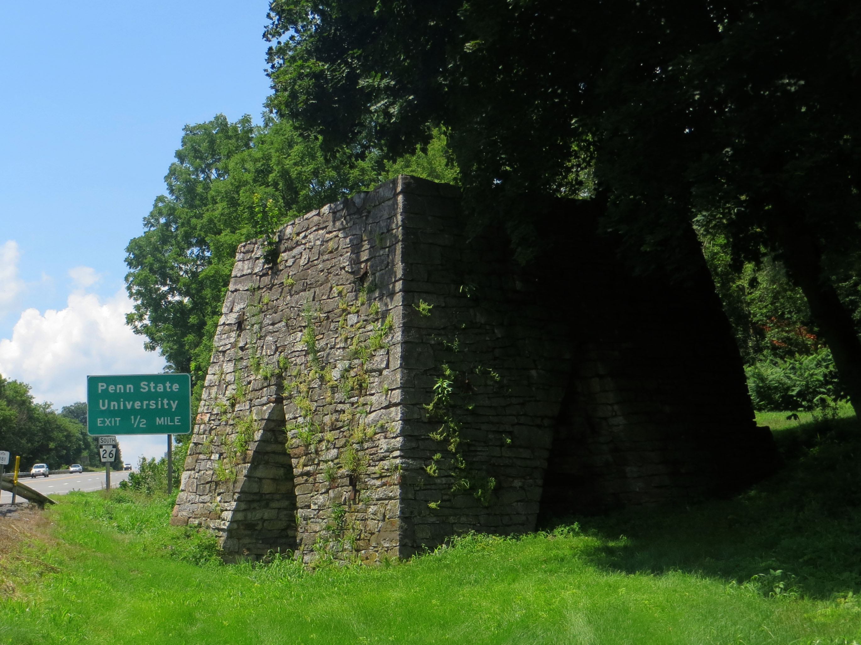

Slide 17
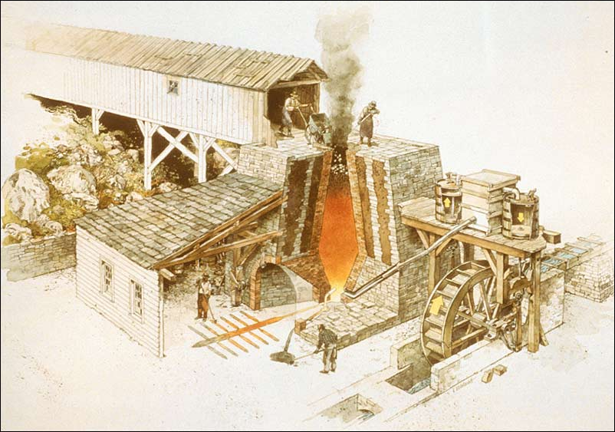
(National Park Service, Richard Schlecht, illustrator)
http://www.cr.nps.gov/nr/twhp/wwwlps/lessons/97hopewell/97visual1.htm

Slide 18
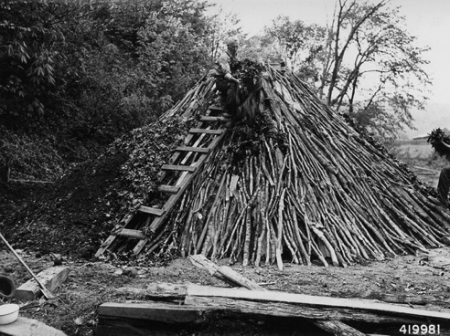
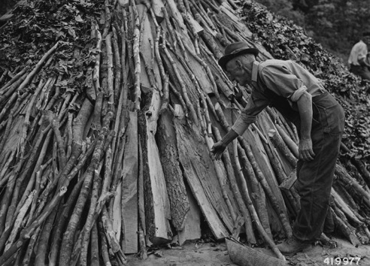
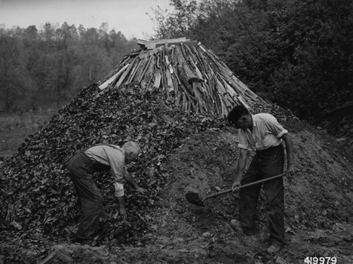
Charcoal making, US National Archives
Notes:
Ones I found at the National Archives that we can use without permissions

Slide 19
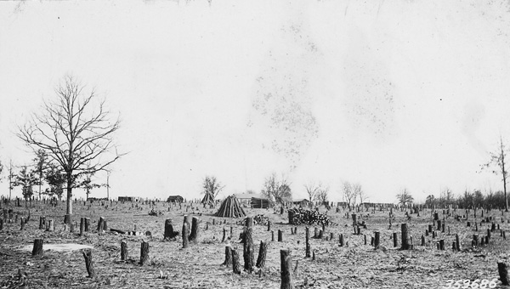
Logging for charcoal—about a square mile of trees per furnace per year to smelt the iron and fuel the workers
Photo US National Archives
Notes:
Ones I found at the National Archives that we can use without permissions

Slide 20
PA place names “Furnace” and “Forge”—and there were more—Greenwood Furnace not on here, for example. Almost 1 square mile of trees per year for a fully functioning furnace (charcoal for iron making plus wood for workers).
http://pennsylvania.hometownlocator.com/

Slide 21
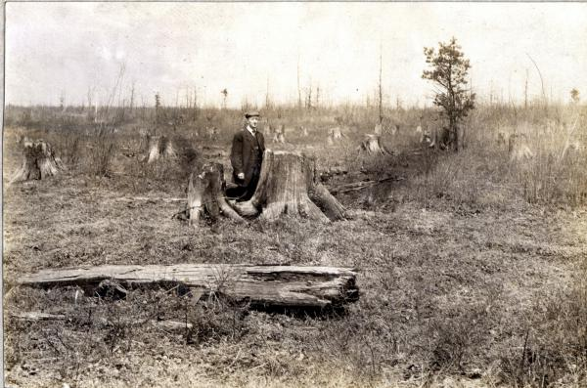
“Penn’s Woods” to “Pennsylvania Desert”
Pennsylvania State Archives, Tioga County, early 1900s, hosted at http://explorepahistory.com/displayimage.php?imgId=1-2-7A
Notes:
Credit: Courtesy Pennsylvania State Archives
This photograph, taken in Tioga County some time in the early 1900s, well documents the deforestation of northern Pennsylvania in the late 1800s and early 1900s. To end the logging practices that had created what he called the "Pennsylvania Desert," and to combat humanity's "tree-destroying instinct," University of Pennsylvania botanist Joseph Rothrock in the 1870s launched a campaign that led to the creation of a state Forestry Commission in the 1890s and state-owned forest reserves that by 2000 included 4 million acres.
http://explorepahistory.com/displayimage.php?imgId=1-2-7A

Slide 22
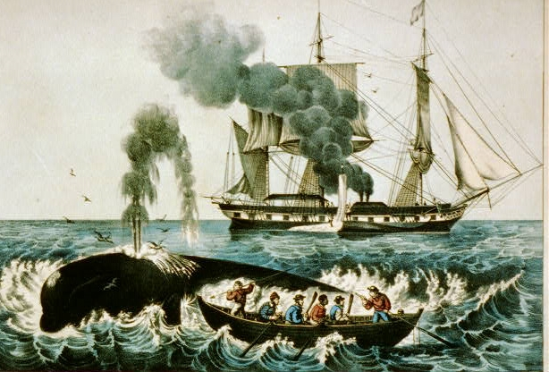
http://www.loc.gov/pictures/item/2002698808/Currier and Ives, Whale Fishery: Attacking a right whale, Library of Congress

Slide 23
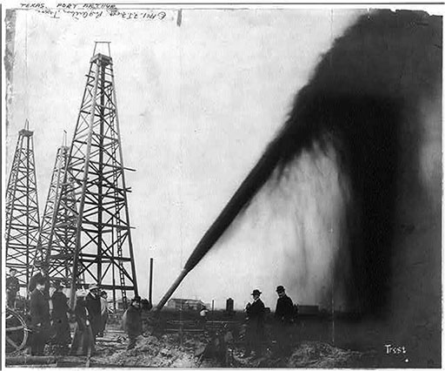
Oil gusher in Port Arthur, Texas, c. 1901 Library of Congress Prints and Photographs Division (link is external). © F.J. Frost, no known restrictions on publication.

Slide 24
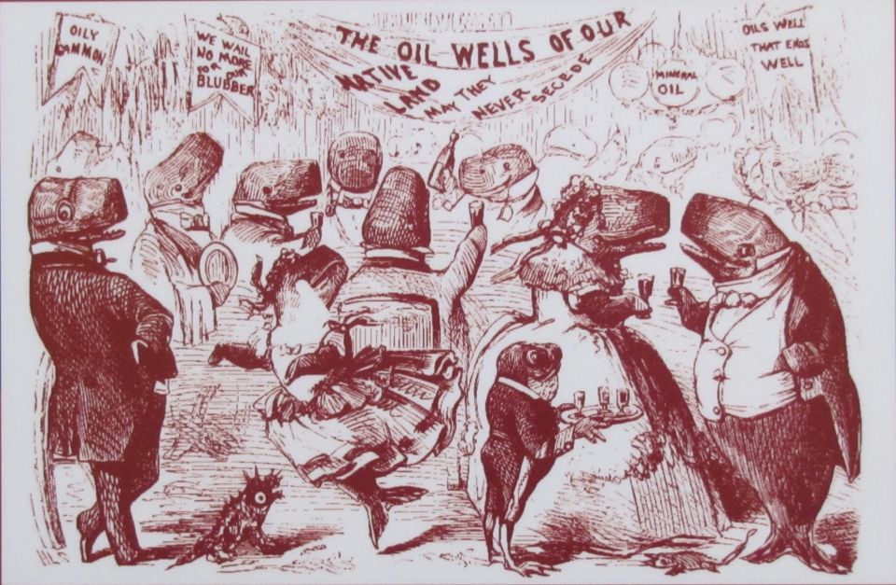
“GRAND BALL GIVEN BY THE WHALES IN HONOR OF THE DISCOVERY OF THE OIL WELLS IN PENNSYLVANIA”, VANITY FAIR, 1861

Slide 25
Per person, per year, in the US
Trash we throw away at the curb:
½ ton
CO₂ we throw away in the air:
20 tons

Slide 26
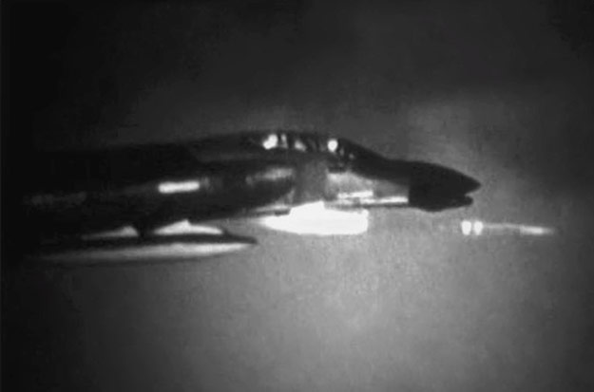
U.S. Department of Defense film, 342-USAF-49391, courtesy of the U.S. National Archives and Records Administration, College Park, MD. Courtesy of Earth: The Operators’ Manual and Geoffrey Haines-Stiles. From https://www.e-education.psu.edu/earth104/node/1258

Slide 27
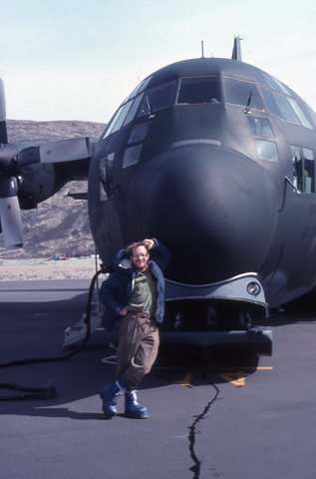
An arson investigator needs to know about natural fires.
We go to Greenland and Antarctica, and many other places, to learn history of climate from ice cores and other archives.
Knowledge of natural climate changes gives very high confidence the changes now occurring are mainly human-caused, and could become much bigger.

Slide 28
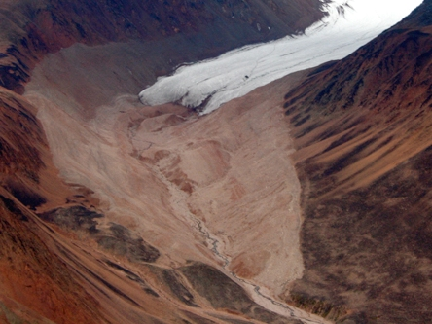

Slide 29
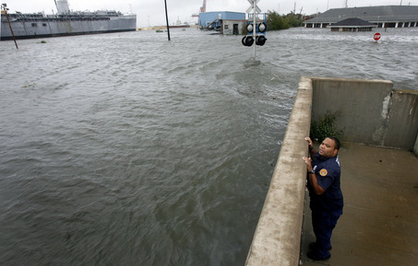
Even a little sea-level rise might matter in some cases. We might cause a lot.
http://www.democraticunderground.com/discuss/duboard.php?az=view_all&address=389x3899732
A New Orleans Police Department officer peers over the Industrial Canal levee
wall from the lower 9th Ward at the high water driven in by Hurricane Gustav.
In the background, upper right is the flooded offices of Southern Scrap.

Slide 30
Averaged over the world
Energy humans use:
0.035 W/m²
Energy the Sun supplies:
240 W/m²

Slide 31
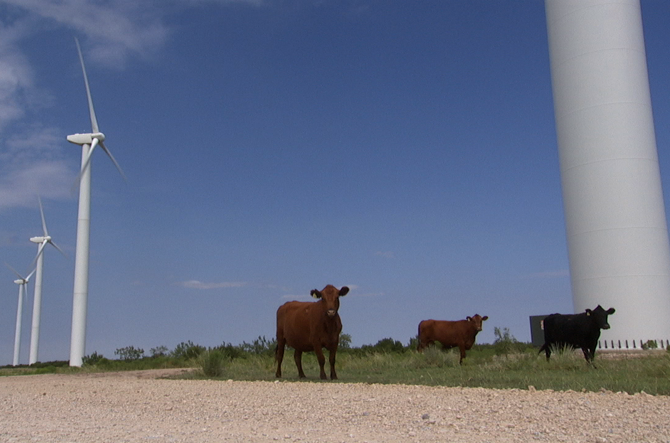
“As yet, the wind is an untamed, and unharnessed force; and quite possibly one of the greatest discoveries hereafter to be made, will be the taming and harnessing of it.” —Abe Lincoln Discoveries and Inventions: A Lecture by Abraham Lincoln Delivered in 1860 (John Howell, San Francisco, 1915).
Wind farm on windy parts of plains and deserts would supply far more energy than humanity uses

Slide 32
~5% of land for wind turbines to make “mailbox money”—more than $5k/turbine/yr, with the rest of the land for “normal” agriculture—even ranchers who don’t believe in climate change do believe in wind energy!
Wind farm on windy parts of plains and deserts would supply far more energy than humanity uses

Slide 33
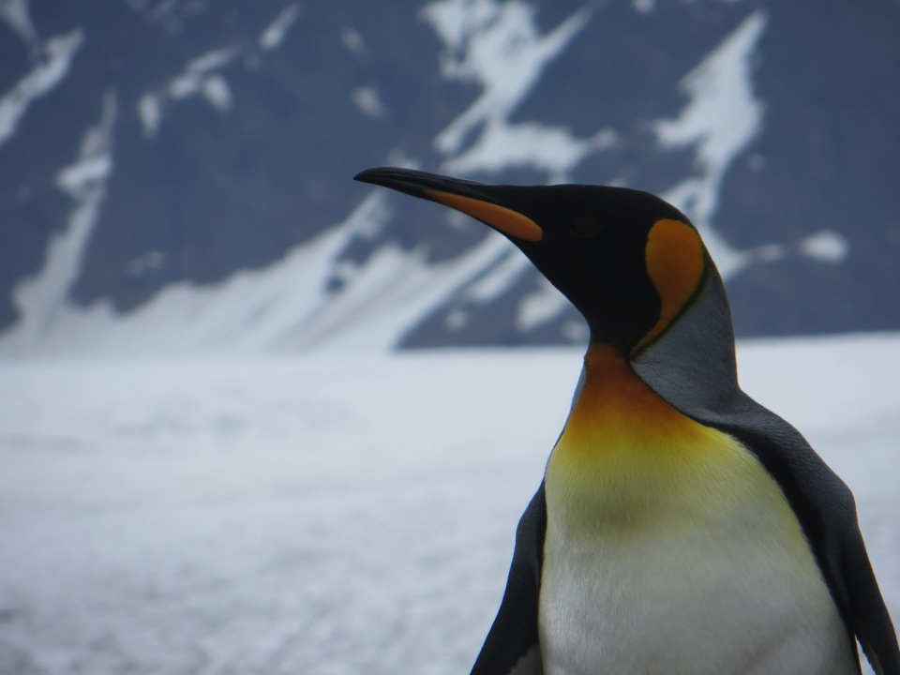
Fantastic opportunities
→ A sustainable future
Energy for everyone
Better economy
Better environment
Better with Golden Rule

Slide 34
