Slide 1
PA Higher Ed Food Recovery Challenge
A partnership driven by Sodexo, PERC and the EPA

Slide 2
PA Higher Ed Food Recovery Challenge
The Problem
A partnership driven by Sodexo, PERC and the EPA

Slide 3
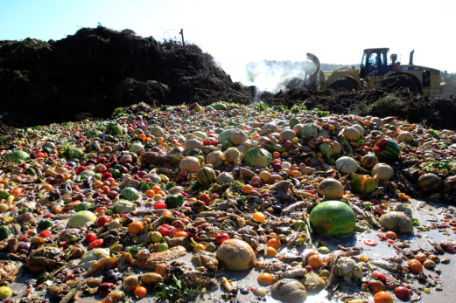
The Problem
2010:
35 million tons of food waste
97%

Slide 4
The Problem
14% of U.S. households are food insecure
1 in 5 kids

Slide 5
The Problem
Wasted food= wasted money

Slide 6
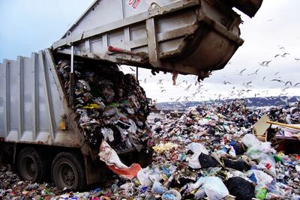
The Problem
Decomposing food generates methane; a potent greenhouse gas
33 times
more potent
than CO²
^{Shindell, et al, Science, 2009}

Slide 7
PA Higher Ed Food Recovery Challenge
The Partnership
A partnership driven by Sodexo, PERC and the EPA

Slide 8
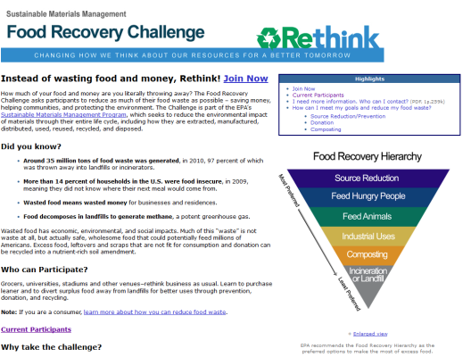
EPA

Slide 9
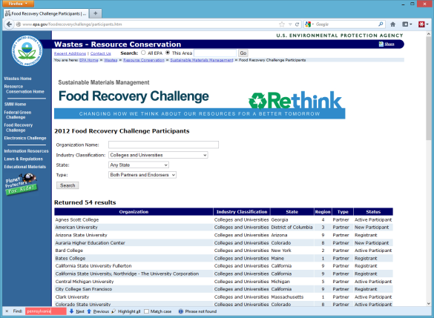
EPA

Slide 10
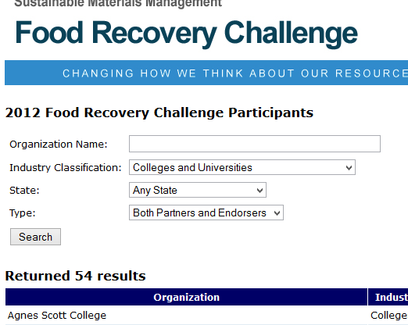
EPA

Slide 11
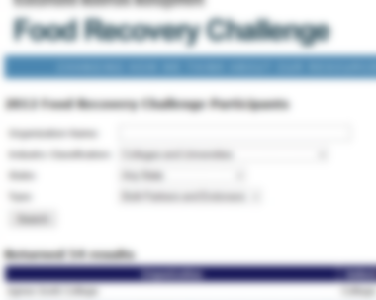
EPA

Slide 12
PA Colleges Food Recovery Challenge
Program
A partnership driven by Sodexo, PERC and the EPA

Slide 13
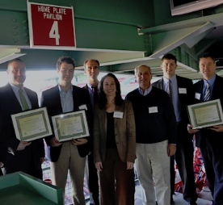
Program
EPA’s Role
Project will use existing EPA tools to catalogue food recovery benchmarks and subsequent progress.
EPA will supply subject experts to help individual schools succeed.
EPA will recognize successes in the project.

Slide 14
Partnership
Sodexo’s Role
Sodexo supplied funding to enable PERC’s implementation of the program.
Sodexo helped to shape the program.
Sodexo enrolls client schools when possible.

Slide 15
Partnership
Any PERC school with any service provider can join.
Sodexo,
Parkhurst
Chartwells
School-provided
Three Areas
Source Reduction
Composting
Donation

Slide 16
Partnership
PERC’s Role
PERC will create a special section of the PERC web site to describe the project and its benefits.
PERC will organize monthly meetings to facilitate communication among participating institutions
PERC will promote the program to schools across the state.
PERC functions as “secretariat.”

Slide 17
PA Colleges Food Recovery Challenge
Where we are
A partnership driven by Sodexo, PERC and the EPA

Slide 20
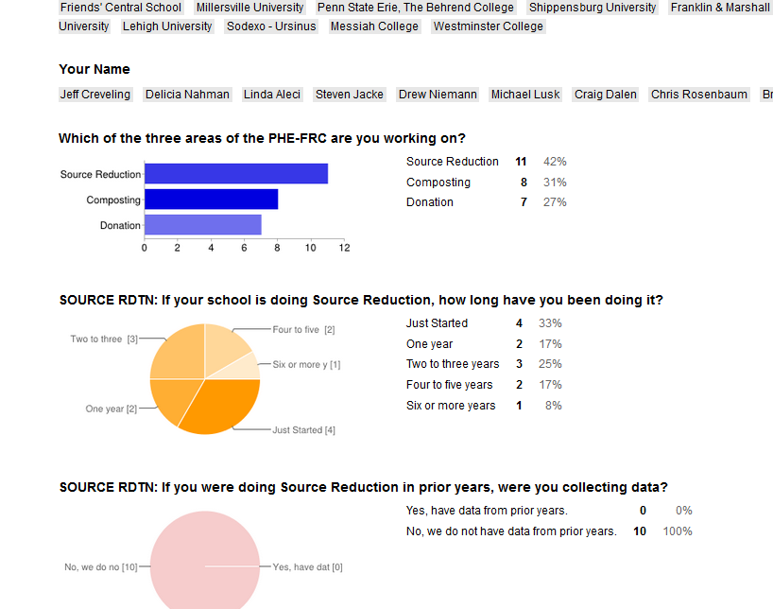
Survey

Slide 21
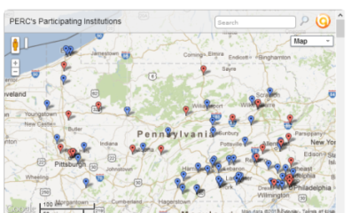
Unique
What other states have a program similar to PERC?
NONE.
Other schools
(None in PA prior)
Other organizations
NHL
Nothing else exactly like this: a statewide food recovery challenge

Slide 22
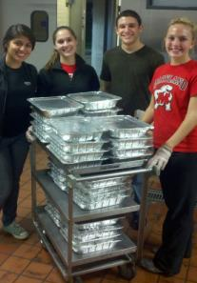
PHE-FRC
Join us
Model for other PERC partnerships?

