Slide 1
PERC Business

Slide 2
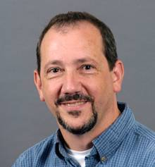
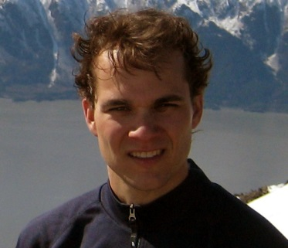
Current Executive Committee
Sarah Dawson: President Liaison and Interim Chair: Green PA Team Director, Wohlsen Center for the Sustainable Environment Franklin & Marshall College
Neil Leary: President-Elect Director, Center for Environmental and Sustainability Education Dickinson College
Tim Hawkins: Treasurer Associate Professor Department of Geography & Earth Science Shippensburg University

Slide 3
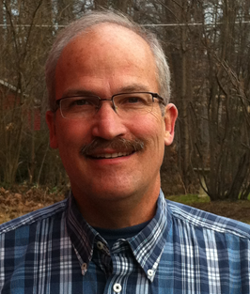
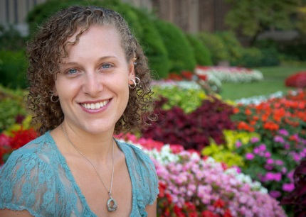
John Olson: Secretary Associate Professor of Biology Chair, President's Environmental Sustainability Committee Villanova University
Rich Bowden Immediate Past President Professor, Environmental Science Allegheny College
Brittany Prischak Liaison and Interim Chair, Campus Sustainability Team Sustainability Officer Mercyhurst College

Slide 4
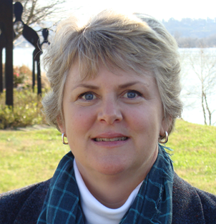
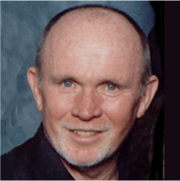
Julia Knight Liaison, Climate Change & Sustainable Energy Team Director of Sustainability HACC
Don Brown Government Liaison PERC Founder Interim Chair: Climate Change & Sustainable Energy Team

Slide 5
Expanding the Executive Comm.
Current
The Executive Committee shall contain eight members of the Board of Governors elected by the Board of Governors.
Proposed
The Executive Committee shall contain up to fourteen members of the Board of Governors elected by the Board of Governors.

Slide 6
Expanding the Executive Comm.
VOTE

Slide 7
Committee standing for election
Returning
Rich Bowden | Allegheny College
Neil Leary | Dickinson College
Sarah Dawson | Franklin & Marshall
Tim Hawkins | Shippensburg Univ.
New Nominees
Susannah Barsom | Penn State University
Kathy Straub | Susquehanna Univ.
Kathleen Schreiber | Millersville Univ.
Additional Nominees?

Slide 8
Committee standing for election
VOTE

Slide 9
Logo

Slide 10
Logo

Slide 12
New Logo
Each school’s rep gets Member version
Each year
Use on your site
Link to us, we link to you.

