Slide 1
Food Recovery Network
Engaging students in the PA Higher Ed Food Recovery Challenge

Slide 2
Eileen Reavey
Director of Expansion
eileen.reavey@foodrecoverynetwork.org
301-693-6033

Slide 3
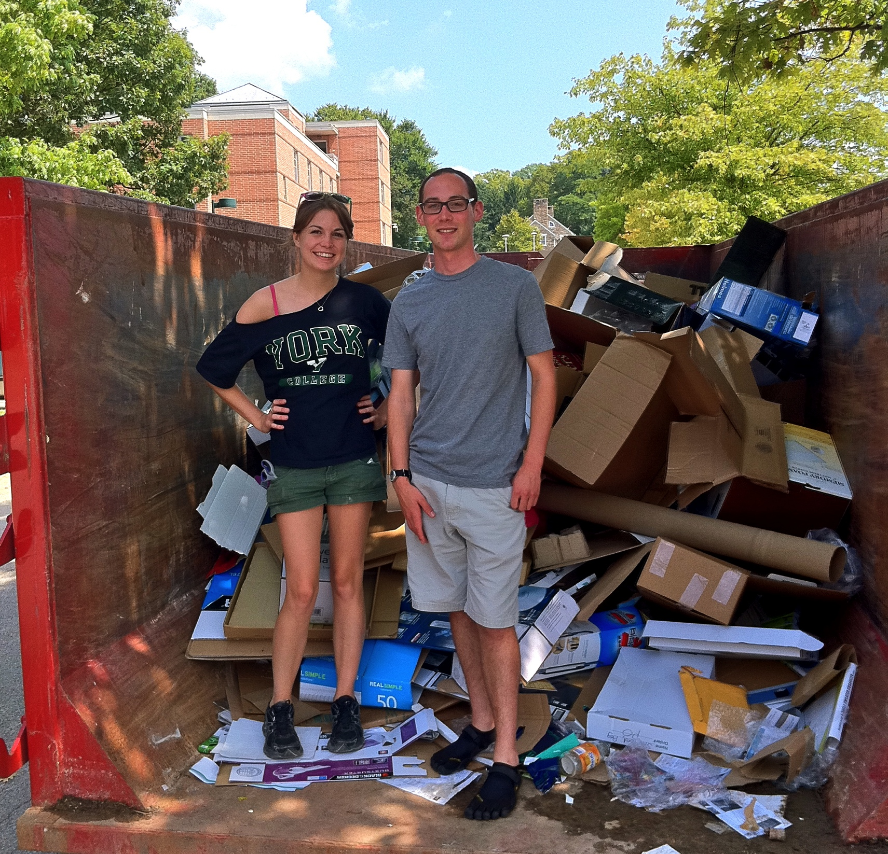
York College of Pennsylvania

Slide 4
FRN @ YCP

Slide 5
Food Recovery on College Campuses
EPA Food Recovery Challenge
Source Reduction
Food Donation
Composting

Slide 7
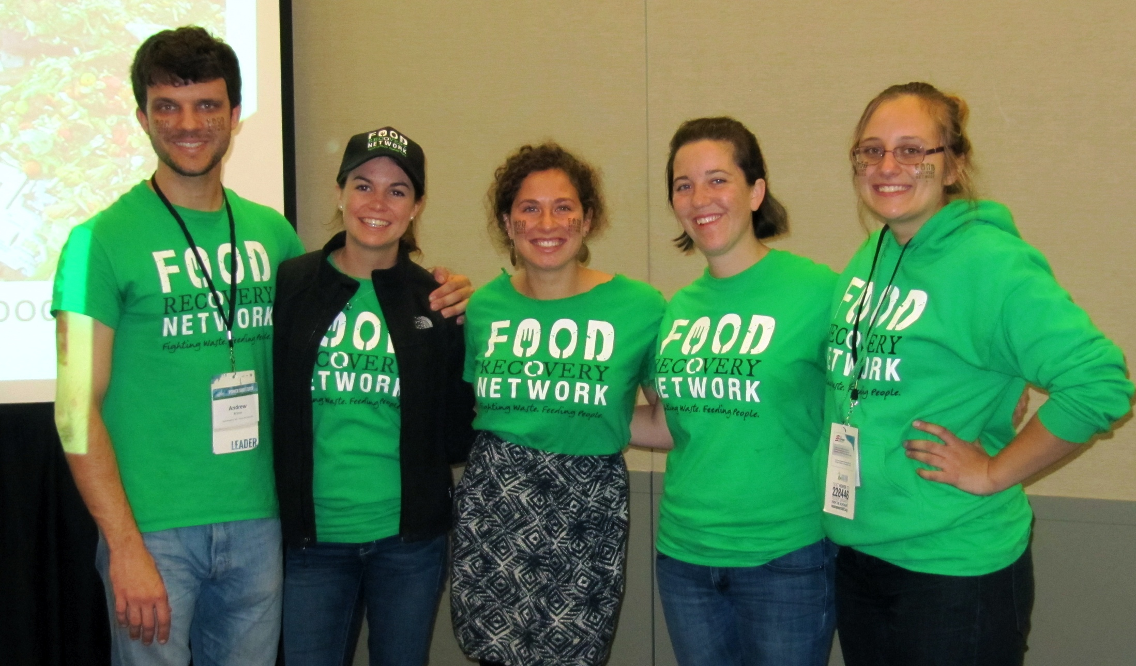
Food Recovery Network
Build a Leadership Team
Partner with a Hunger Fighting Agency
Figure out Transportation
Approval from Dining Manager

Slide 8
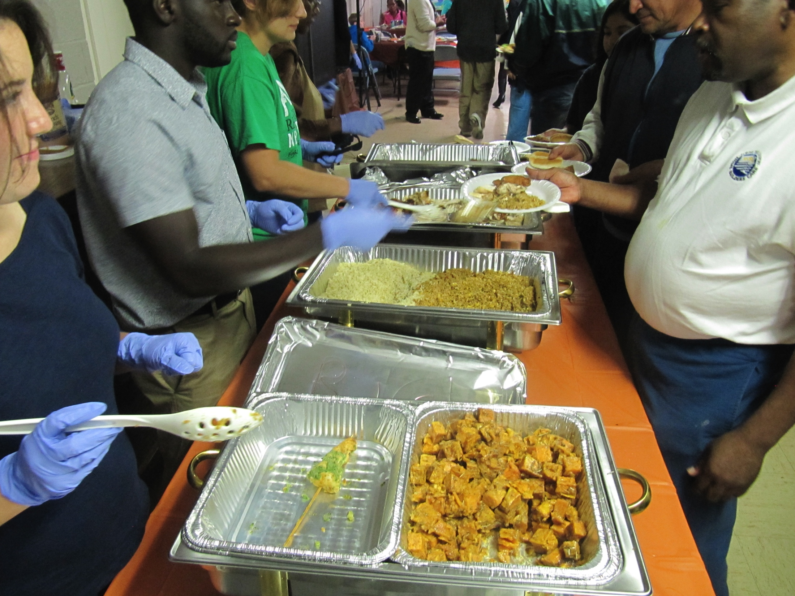
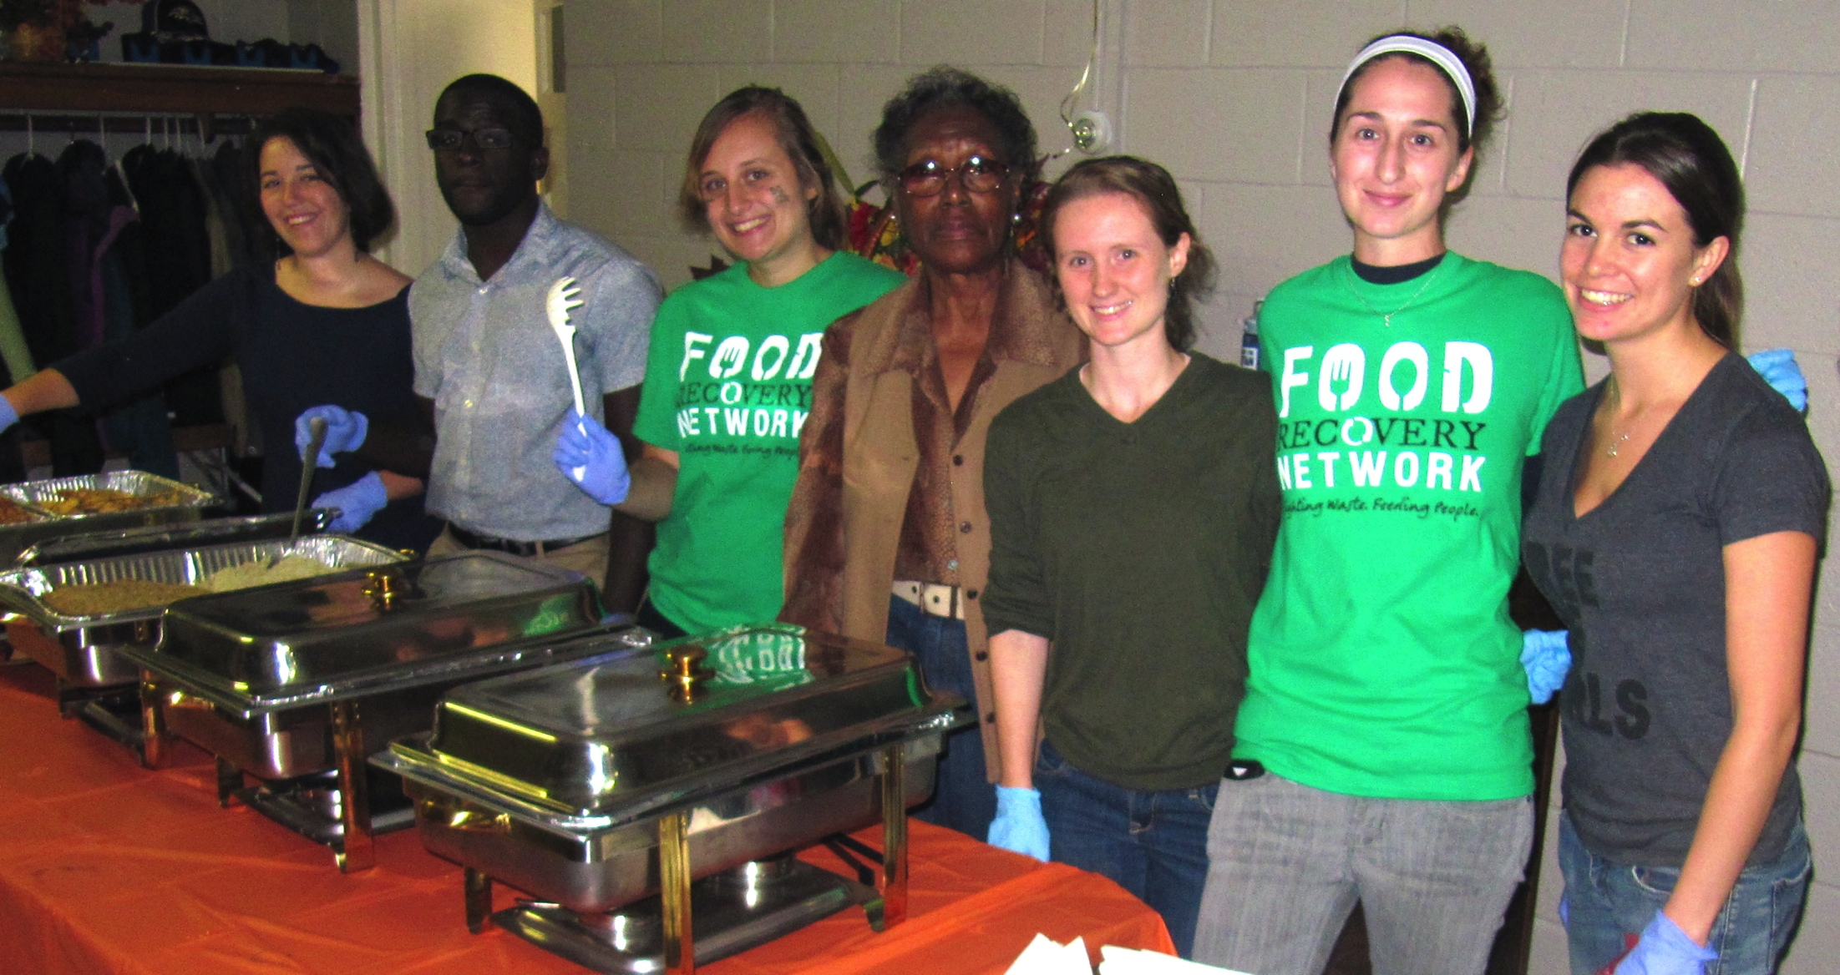
In the past 2 years…
500+ Volunteers
31 Campuses
190,000 pounds of donated food
38 Partner Agencies
National Partnerships with Sodexo & Bon Appetit

Slide 9
Road to FRN
EPA
Food Recovery Challenge
PERC
Food Donation
FRN
Student Involvement

Slide 10
Where we are in Pennsylvania…
Official Chapters
Chapters in Progress
Allegheny College
Drexel
Villanova
York College of Pennsylvania
Arcadia University
St. Joseph’s University
Penn State University Park
Indiana University of Pennsylvania
Kutztown University
University of Pennsylvania
Penn State – Abington
University of Pittsburgh

Slide 11
Engaging Students in the PA Higher Ed Food Recovery Challenge
Student Organizations
Environmental
Hunger Fighting
Social Justice
Volunteerism
Senate
Talking to classes
Tabling/Flyering around campus

Slide 12
Eileen Reavey
Director of Expansion
eileen.reavey@foodrecoverynetwork.org
301-693-6033

