Slide 1
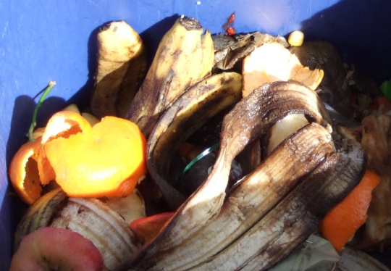
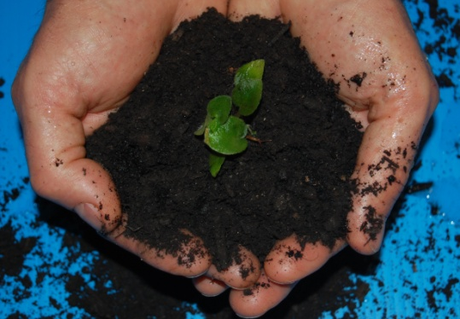
“Building Bridges” -The PA Higher Education Food Recovery Challenge
Luke Wolfgang, USEPA Sustainability Coordinator
wolfgang.luke@epa.gov

Slide 2
Presentation Overview
Defining the Food Waste Problem in the U.S.
EPA’s Food Recovery Challenge Program
Overview of the PA Higher Education Food Recovery Challenge Partnership Project
2 Year Results

Slide 3
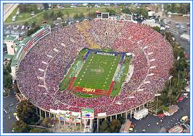
The Food Waste Problem
Americans waste enough food to fill the Rose Bowl every day. (Bloom 2007)
Notes:
44% of the food produced and imported in the US ends up in the landfill or compost pile.
NOTE: This estimate is from Jonathan Bloom’s book American Wasteland. It’s based on a volumetric calculation for the Rosebowl capacity using EPA data on the amount of food waste disposal annually.

Slide 4
So how much food waste are we generating?
Food is the #1 Waste Stream
Notes:
That makes Food waste the single largest component of our municipal solid waste stream that ends up in the landfill.

Slide 5
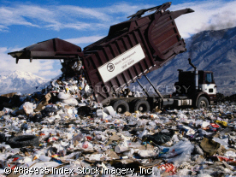
Food Waste Impacts the Economy
Financially, wasted food costs America more than $100 billion annually. (Bloom, 2007)
Disposal cost of municipal waste management
Over purchasing costs
Cost of lost energy
Notes:
US families throw out approximately 25% of what they buy. The cost estimate for the avg family of four is $1365 – 2275 annually.

Slide 6
It impacts Society
50 million Americans, or 14% of American households, were food insecure in 2009. (USDA)
Food insecurity can increase the likelihood for an individual to have major health concerns.
Notes:
1 in 6 people in US are food insecure. Effects children and seniors disproportionally.
Food insecurity is when people don’t “at all times have access to sufficient, safe, nutritious food to maintain a healthy and active life”. (World Food Summit, 1996).
It is estimated that food saved by reducing losses by just 15% could feed more than 25 million americans every year.

Slide 7
It Impacts the Environment
Food that enters a landfill produces methane, a greenhouse gas with 21 times the warming potential of CO₂

Slide 8
Sustainable Food Management
Notes:
Environmental
- Food that enters a landfill produces methane, a greenhouse gas with 21 times the warming potential of CO₂
Landfills are the second greatest source of methane.
Social
50 million Americans, or 14% of American households, were food insecure in 2009 (USDA).
- Food insecurity can increase the likelihood for an individual to have major health concerns.
Economic
Wasted food costs America more than $100 billion annually (Bloom, 2007)
- Costs from disposal of municipal waste
- Costs from over-purchasing
- Costs from inefficient prep
- Costs from energy?

Slide 9
Recognition & Awards
Technical Tools / Assistance
Waste Tracking System
EPA’s Food Recovery Challenge: A Tool to Reduce Food Waste
Cost Savings, Brand Recognition, Community Involvement, and
Reduce Environmental Impact
Notes:
Improve your bottom line through cost savings from reduced purchasing and waste fees and improves your image
Supports your community by feeding people, not landfills
Reduces greenhouse gas emissions by disposal of food in landfills, which converts to methane a potent ghg.

Slide 10
Reduce
Max
Green House Gas
Cost Savings
Generate
None

Slide 11
Food Recovery Challenge Participant Benefits
Data Management System
Tracks food waste diversion activities
Web-based and secure
Converts to GHG and other metrics
EPA Awards and Recognition
Technical assistance from EPA
Regular webinars on food waste related issues
Website with case studies, tools, templates, and other outreach materials
Notes:
Flexible - With the WasteWise Re-TRAC data management system, users can manage multiple facilities, control which users have access to each facility, and input data as frequently as desired - daily, weekly, monthly, quarterly, yearly.
Web-based - Re-TRAC can be accessed anytime, anywhere by multiple users.
Measurable - GHG emission reductions can be calculated instantly and translated into real-life equivalents, such as cars off the road.
Secure - WasteWise Re-TRAC uses a multi-tiered security system to ensure your data remains safe.

Slide 12
Food Recovery Challenge Program Requirements are as Easy as 123…
Baseline and Goal Setting
Implement a Food Diversion Program
Donation, Composting, Prevention
Report at the End of the Year

Slide 13
PA Higher Education Food Recovery Challenge
A partnership driven by Sodexo, PERC and the EPA

Slide 14
Partnership
Leadership
Content
Connection

Slide 15
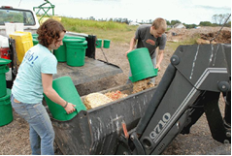
Non-Profit, Public, Private Partnership
Leadership
Funding
Participation
Promotion to schools
Communication Infrastructure
Competitive feedback
Secretariat
Content
Leadership
Program
Technical experts
External Recognition
Connection

Slide 16
2 Year Environmental Results
Food Diverted From Landfill:
65.61 Tons in 2013, 125.4 Tons in 2014
Environmental Outcomes:
263 MTCO2 Reduced
415 MBTU Energy Saved

Slide 17
2 Year Results Continued…
Environmental Equivalencies:
4 Households Energy Consumption
72 Barrels of Oil
3,232 Gallons of Gasoline
16,783 Meals Served

Slide 18
Award Winning Program

Slide 19
Take the
PA Higher Education Food Recovery Challenge
and
together – let’s take a bite out of food waste!

Slide 20
For More Information or to Join….
http://www.pagreencolleges.org/signup
Josh Hooper
josh.hooper@pagreencolleges.org
Luke Wolfgang
wolfgang.luke@epa.gov

