Slide 1
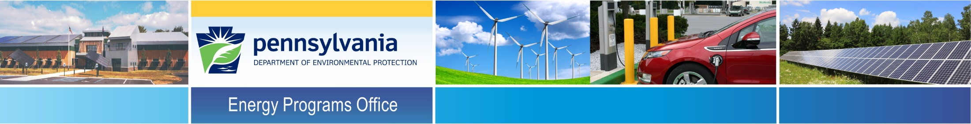
Pennsylvania Department of Environmental Protection
The Power of Partnerships in
Leading by Example
January 10, 2020
Tom Wolf, Governor
Patrick McDonnell, Secretary

Slide 2
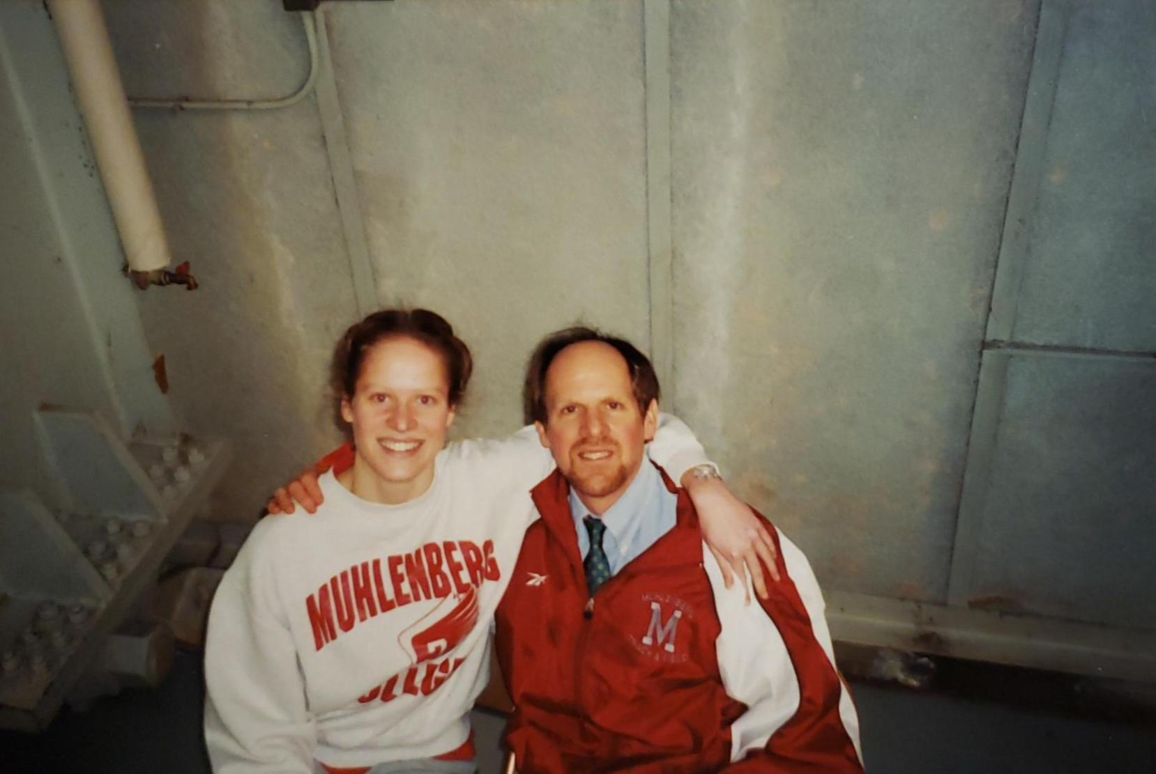

Slide 3




DEP Energy Programs Office (EPO)
Mission
We will work as partners with individuals, organizations, governments and businesses to achieve a balance in the energy sector for deploying energy technologies that prevent pollution, protect our natural resources while ensuring affordable and abundant energy resources for Pennsylvanians that support economic growth.

Slide 4
EPO Responsibilities
Climate
  Abide by the DEP duties set forth in Act 70 of 2008 (PA Climate Change Act), including:
    Climate Action Plan
    Climate Impacts Assessment
    Annual greenhouse gas inventory
    Establish & manage a Climate Change Advisory Committee
Energy Efficiency, Conservation & Renewable Energy
  Implementation of programs for energy conservation, energy efficiency, and renewable energy programs

Slide 5
EPO Responsibilities
Alternative Transportation
  Administration of programs to stimulate the use of domestically produced alternative fuels and innovative transportation technologies that reduce emissions from mobile sources
Energy Assurance
  The primary entity for programmatic support of Commonwealth’s Emergency Support Function #12 “energy emergency”
Education/Outreach/Collaboration
  Inform & educate PA citizens on the health, environmental, & economic benefits of energy conservation, energy efficiency, & renewable energy

Slide 6
EPO Partners
EPO’s efforts are supported by working with 3rd party partners, such as:
  Contractors:
    PennTAP
    PennFuture
    ICF
    VEIC
  Government:
    US DOE
    US EPA
    PUC, PEMA, Treasury
    DCED, DGS, Dept of Ag, PennDOT
    Counties, Municipalities, Cities
  PA and National Non-profits
    KEEA, ACEEE, NEEP, ICLEI, GBCI
  Academia
    PSU, Penn College of Technology, Lehigh, CMU, etc.

Slide 7
Lead by Example – State Government
Executive Order 2019-01
Commonwealth Leadership in Addressing Climate Change and Promoting Energy Conservation and Sustainable Governance
Sets a statewide goal to reduce greenhouse gas emissions 26 percent by 2025, and 80 percent by 2050
Sets Performance goals for state government (2025):
  Energy Efficiency
  High Performance Buildings (new/major renovations)
  Electric Vehicles
  Renewable Energy Procurement
Establishes the GreenGov Council
  DEP will partner with the Department of General Services and Department of Conservation and Natural Resources to develop strategies to ensure state government meets these goals

Slide 8
Alternative Fuels Incentive Grant
PA Climate Action Plan 2018
Goals of the Climate Action Plan (CAP):
Reduce GHG emissions
Minimize disruptions to Pennsylvania’s citizens, economy, and environment from climate-related hazards.
Increase Pennsylvania’s ability to prepare for and adapt to changing conditions and respond to and recover from climate-related disruptions.
Maintain cost-effectiveness.

Slide 9
Alternative Fuels Incentive Grant
GHG Emissions by Sector in 2016

Slide 10
Alternative Fuels Incentive Grant
Nineteen CAP Strategies
Increase end use energy conservation & efficiency
Implement sustainable transportation planning & practices
Develop, promote, & use financing options to encourage energy efficiency
Increase use of clean, distributed electricity generation resources
Create a diverse portfolio of clean, utility-scale electricity generation
Reduce upstream impacts of fossil fuel energy production
Increase production & use of alternative fuels
Use agricultural best practices
Provide resources & technical assistance to farmers to adapt
Protect ecosystem resilience, including forest systems where species will shift
Monitor, identify, & address ecosystem vulnerabilities
Help the outdoor tourism industry manage shifting climate patterns
Reduce & use waste sent to landfills
Use storm water best management practices
Promote integrated water resources management & water conservation
Improve reliability & accessibility of public information about climate-related health risks
Bolster emergency preparedness and response
Lead by example in commonwealth & local government practices & assets
Incorporate historical & projected climate conditions into siting & design decisions for long-term infrastructure

Slide 11
Local Climate Action Assistance Program
Inspiration & Input:
Don Brown, Widener Law School
Josh Hooper, PERC
John Quigley, Harrisburg University
Brandi Robinson, Penn State University
Chris Steuer, Millersville University
Douglas Smith, City of Lancaster
US EPA
CARB
ICLEI USA

Slide 12
Local Climate Action Assistance Program
ICLEI Local Governments for Sustainability – USA hired as contractor
College student matched with local government
ICLEI trains student on inventory tool (fall semester) and climate action planning (spring semester)
Final product: 20 GHG inventories & 20 local climate action plans
First training webinar in early September 2019 & final work completed by June 30, 2020

Slide 13
Local Climate Action Assistance Program
Timeline:
July 1, 2019 – project work officially began
Sept. 5, 2019 – 1st webinar for fall cohort (GHG inventories)
Nov. 13, 2019 – final webinar for fall cohort
December 2019/End of semester – 20 inventories finalized
Week of Jan. 13, 2020 – 1st webinar for spring cohort (CAPs)
Jan/Feb 2020 – post program materials on DEP website
Week of Apr. 13, 2020 – final webinar for spring cohort
June 2020/End of semester – 20 CAPs finalized
July 2020 – Start another cohort with new local govs, as well as a CAP implementation program for the 2019-2020 participants*
*Dependent on approval of these 2 programs by DEP & US Dept. of Energy

Slide 14
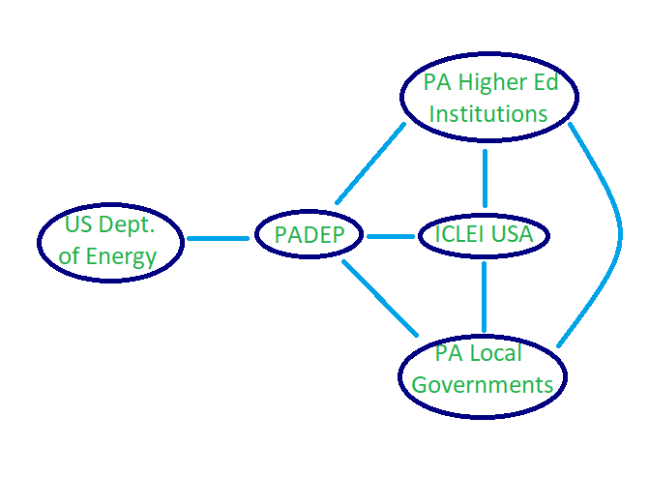
Local Climate Action Assistance Program

Slide 15
Participating Local Governments
Caln Township
Narberth Borough
Jermyn Borough
Carlisle Borough
Derry Township
Armstrong Township
Bellefonte Borough
Indiana Borough
Millvale Borough
Etna Borough
Sharpsburg Borough
West Homestead Borough
Borough of Munhall
Elizabeth Township
Borough of Forest Hills
City of Reading
City of York
Chester County
Erie County
Centre Region Council of Governments

Slide 16
Participating Academic Institutions
Drexel University
Temple University
Wilkes University
Millersville University
Lebanon Valley College
Dickinson College
Shippensburg University
Penn State College of Medicine
Penn State Harrisburg
Penn State University
Susquehanna University
University of Pittsburgh
Allegheny College
Muhlenberg College

Slide 17
Formats for Student Engagement
Capstone project
Honors thesis
Internship
Fellowship
Volunteer
Independent study
Whole class

Slide 18
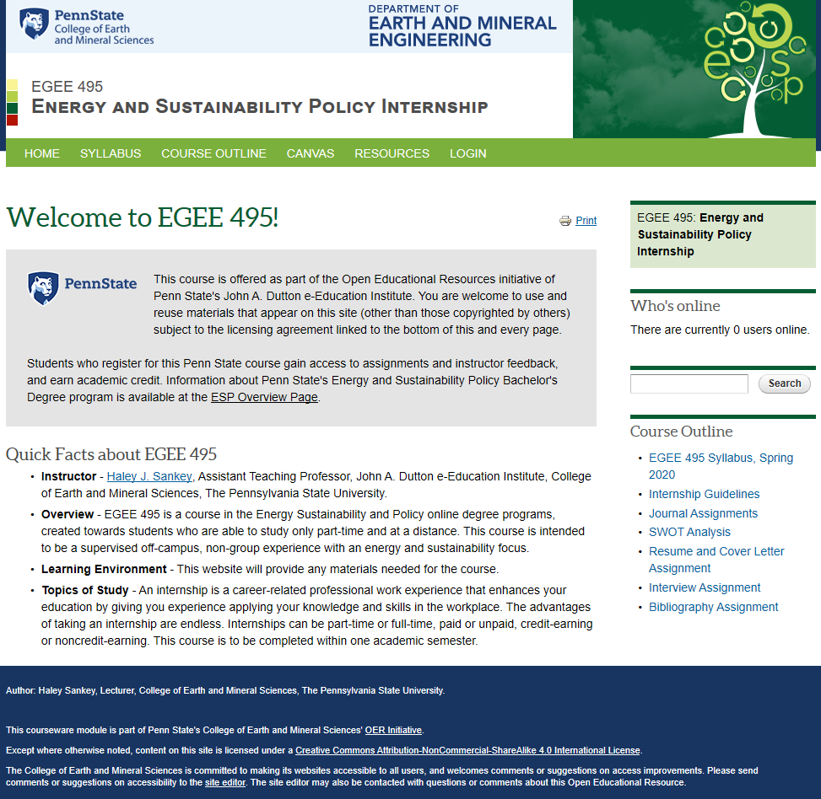
Formats for Student Engagement

Slide 19
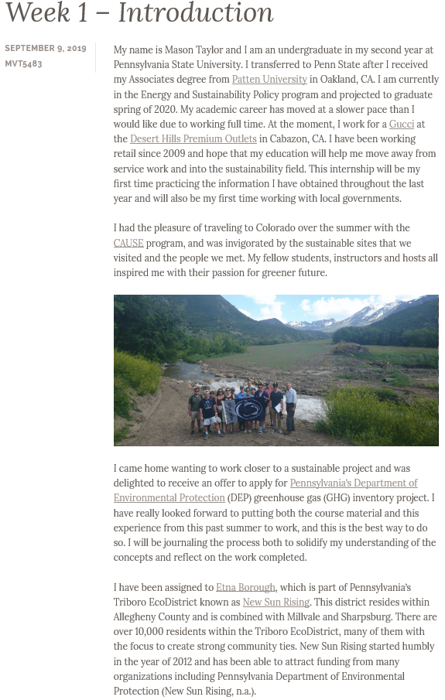
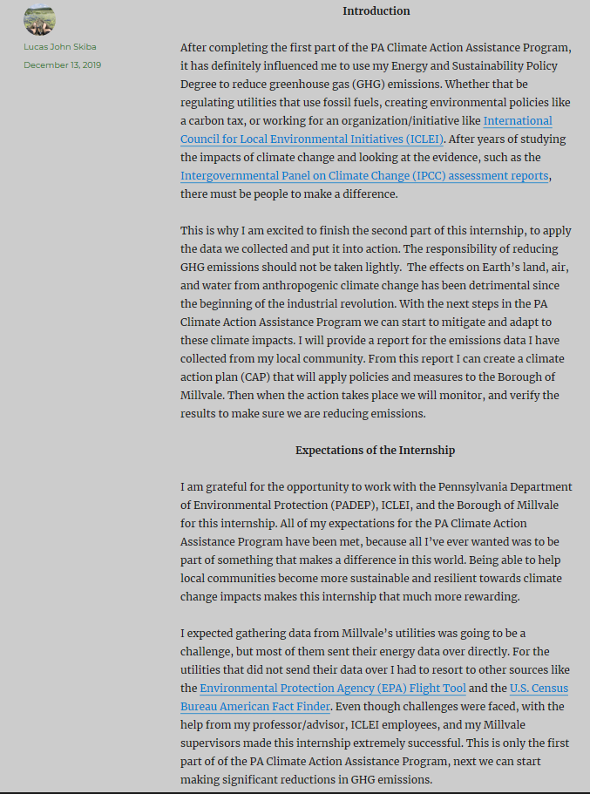
Formats for Student Engagement

Slide 20
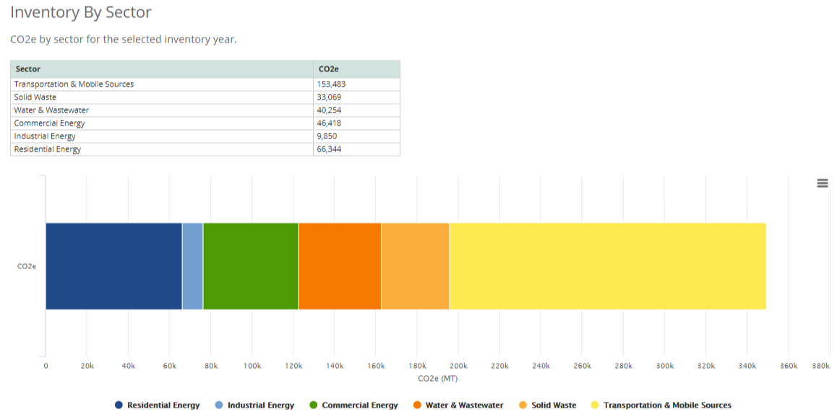
Final Product of Fall Cohort
City of York

Slide 21
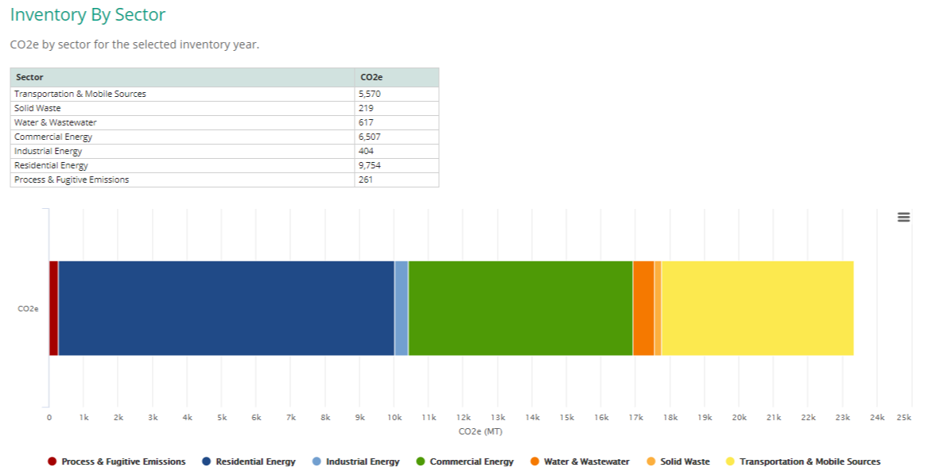
Final Product of Fall Cohort
Bellefonte Borough

Slide 22
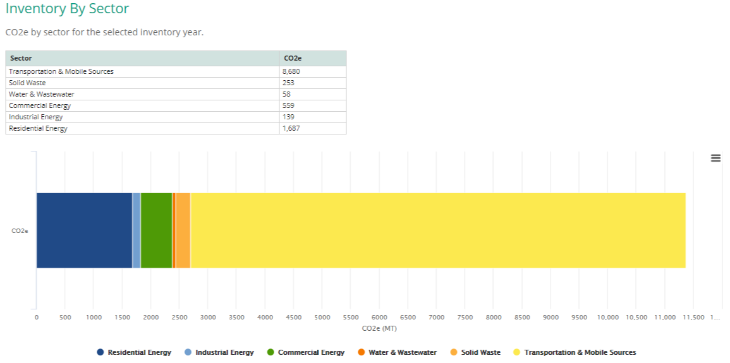
Final Product of Fall Cohort
Armstrong Township

Slide 23
Local Climate Action Assistance Program
What has worked well:
Local professionals/climate advocates who are spreading the word about the program
College advisors who are engaged
  Have created their own student application & selection process for the program
  Have found new students for me
  Are finding ways to expand the program

Slide 24
Local Climate Action Assistance Program
What has not worked well:
Data collection process for GHG inventories
Level of interaction between participants
GHG inventory work is not a consistent workload, so one student did not meet hours required to get full credit for internship

Slide 25
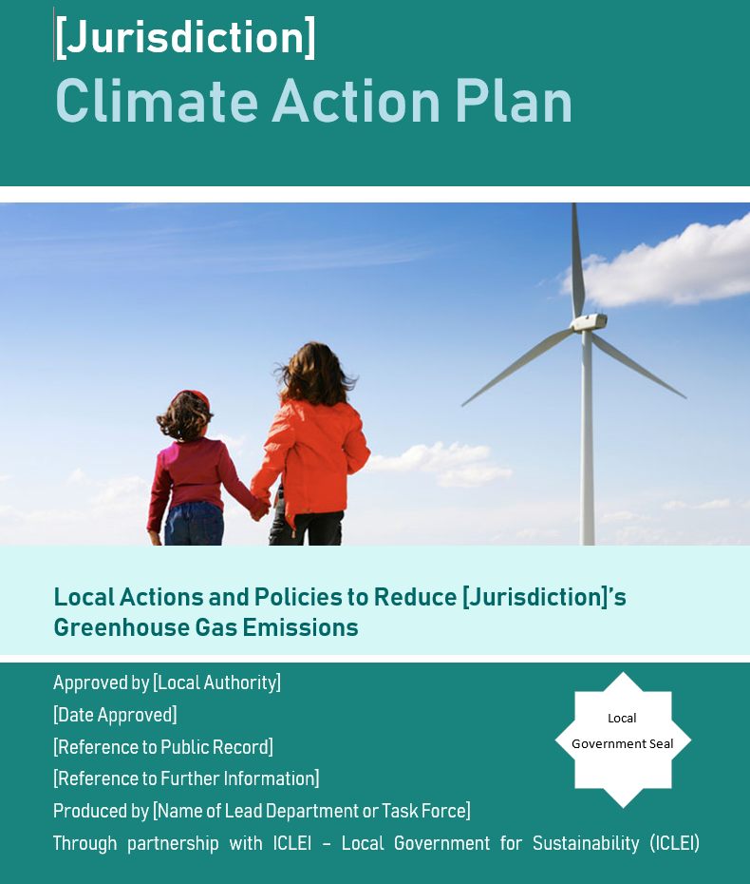
Spring Cohort

Slide 26









Crosswalk with United Nation Sustainable Development Goals
How Does Climate Action Align with UN SDGs?

Slide 27

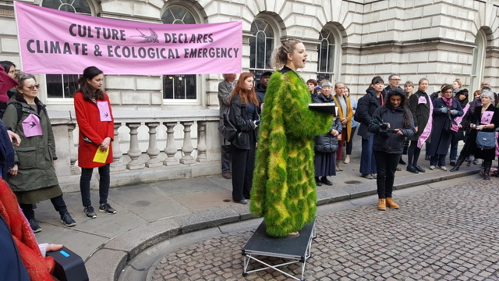
Alternative Fuels Incentive Grant
Cross-Disciplinary Partnerships

Slide 28

Alternative Fuels Incentive Grant
Questions

Slide 29
Feedback
How can we improve and expand this program?
How can we better engage higher ed institutions in this program?
How could we engage college students in the CAP implementation efforts of the current 20 participating municipalities?

Slide 30
Thank you!
Heidi Kunka, LEED AP BD+C, CC-P
Energy Program Specialist
Energy Programs Office
      hkunka@pa.gov
      717.214.4243
      DEP Website: www.dep.pa.gov

