Slide 1
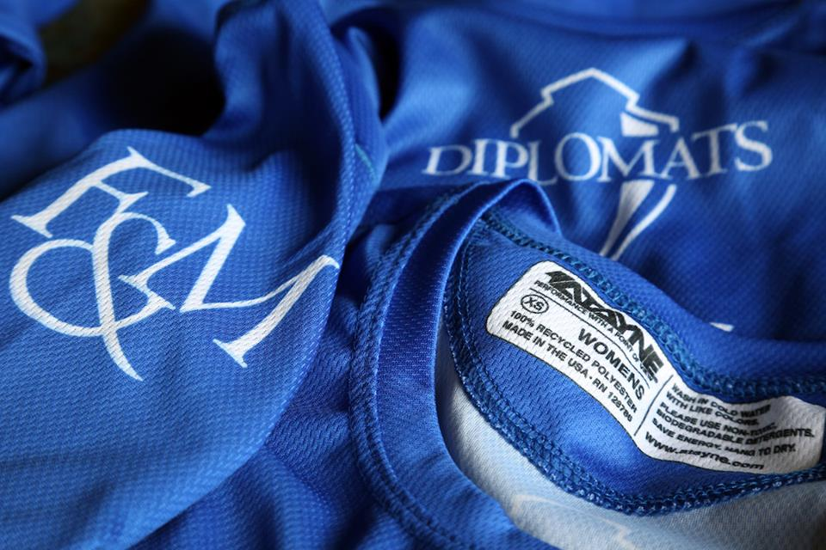
Green Athletics: Recycled Uniforms
Ellie Ezekiel
Franklin & Marshall College

