Slide 1
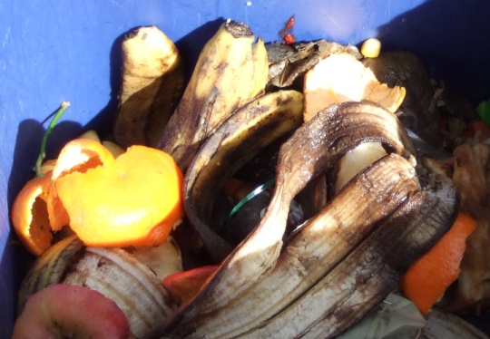
“Changing Times” -The PA Higher Education Food Recovery Challenge
Luke Wolfgang, USEPA Sustainability Coordinator
wolfgang.luke@epa.gov
October 24, 2016

Slide 2
Presentation Overview
Overview of the PA Higher Education Food Recovery Challenge Partnership Project
3 year Results
Case Study: Cabrini’s “Serving Food Solutions” Student Project

Slide 3
PA Higher Education Food Recovery Challenge
A partnership driven by Sodexo, PERC and the EPA
Notes:
Three Legs of Stool: Leadership (Sodexo), Content (EPA), Connection (PERC)

Slide 4
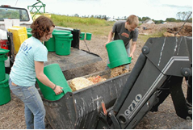
Leadership
Funding
Participation
Promotion to schools
Communication Infrastructure
Competitive feedback
Secretariat
Content
Leadership
Program
Technical experts
External Recognition
Connection
Notes:
Non-Profit, Public, Private Partnership

Slide 5
The Platform: EPA’s Food Recovery Challenge

Slide 6
3 Year Environmental Results
Total Food Diverted From Landfill:
482 Tons as of 2015
441.23 Tons of Composting
26.05 Tons of Prevention
29,240lbs of Food Donation
Environmental Outcomes:
428 MTCO2E Reduced

Slide 7
3 Year Results Continued…
Environmental Equivalencies:
103 Passenger Vehicles
54,928 Gallons of Gasoline
52 Households
24,367 Meals Served

Slide 8
Award Winning Program

Slide 9
Award Winning Program Continued..
PERC won 2014 FRC Endorser of the Year
Cabrini Communications Students won 2015 Davey Awards (Silver Winner)
2 more national FRC award winners from PA-HE FRC will be announced for 2016
Winners Announced on the Quarterly Call December 6th at 2:30pm

Slide 10
Case Study
Establishing a Food Recovery Network (FRN) Chapter at Cabrini University
PERC → Sodexo → FRN → Communications Department → Student Led Community Project
Established a Capstone Honors Project focusing on Food Insecurity in the surrounding community
Project focusses on What is Food Insecurity, Problem, Consequences, and Solutions
Student Legacy Project

Slide 11
servingfoodsolutions.com

Slide 12
Take the
PA Higher Education Food Recovery Challenge
and
together – let’s take a bite out of food waste!

Slide 13
For More Information or to Join….
http://www.pagreencolleges.org/signup
Josh Hooper
josh.hooper@pagreencolleges.org
Luke Wolfgang
wolfgang.luke@epa.gov

